Slide 1
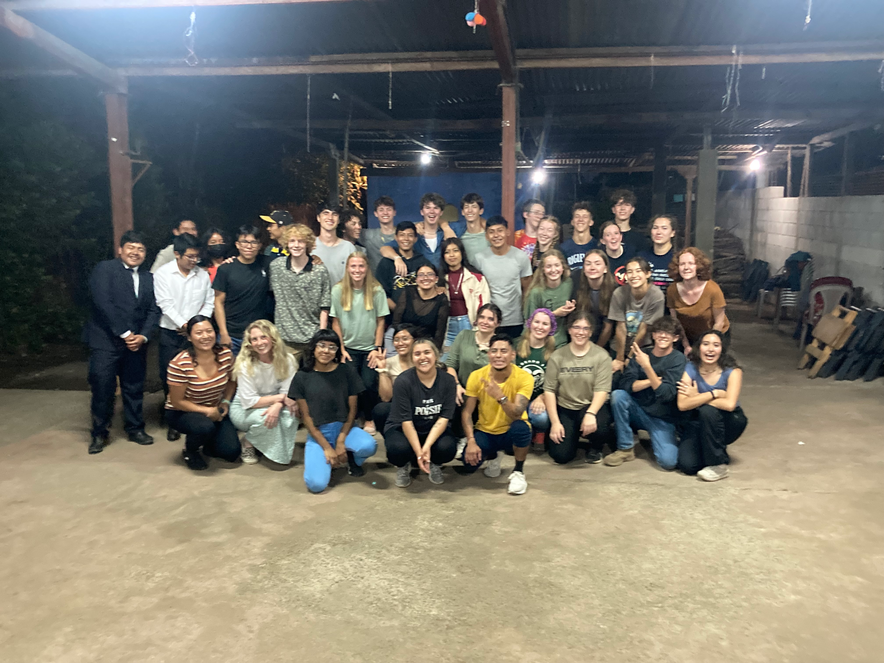
Global Leaders 2023-2024 Leadership Program

Slide 2
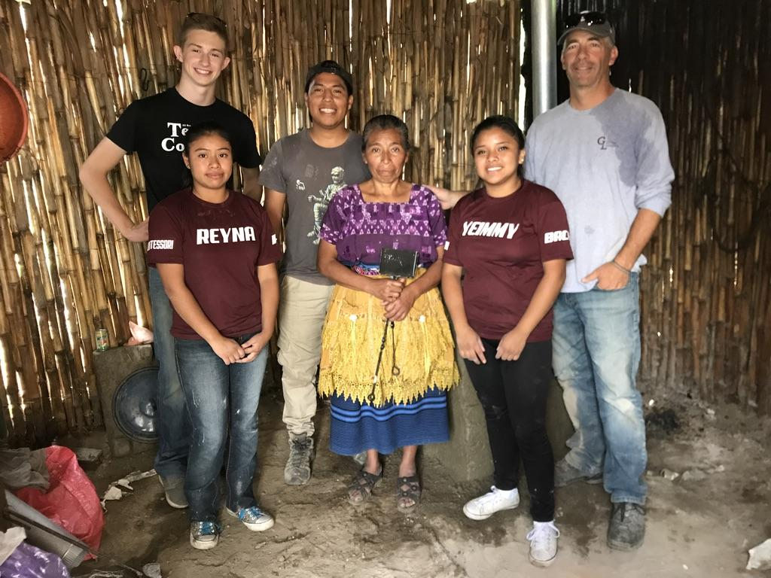
Tonight’s Agenda:
YOUR FOLDER HAS ALL THIS INFO!
GL Contact info/Logging Service Hours
Student Mandatory Activities, Events and Meetings
GL Calendars
GL Fundraising Philosophy
Fundraising Goals
Sample Fundraising Letters Projects
Where does fundraising $ get distributed?
Parent Assistance Needed
Financial Assistance Explanation
Signature Page

Slide 3
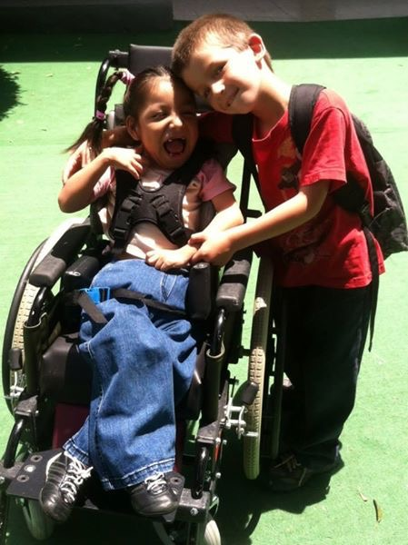
Service-Learning
Global Leaders believes that building an ethic
of service is the foundation of leadership.
By participating in GL, you are:
Opening your eyes to the importance of service and compassion
by leading others to bring positive change through your actions.
Gaining self-confidence, awareness and leadership skills by stepping outside your comfort zone. This growth is irreversible.
Experiencing the thrill of traveling and participating in the culture of a different country.

Slide 4
GL Staff Contact Info: Page 2
GL Office: 970-672-7060 info@globalleadersinc.org
Joe Fontana: 970-566-3776 jfontana@globalleadersinc.org
Kyla Worth: 970-556-5842 kyla@globalleadersinc.org
Skyler Halopoff: 970-430-7386 skyler@globalleaderasinc.org
Robert Laurie: 970-488-7115 robert@globalleadersinc.org
Steph Gutierrez: 719-502-7616 steph@globalleadersinc.org
Lisa Mahler: 970-488-6052 lisa@globalleadersinc.org
Please input the office phone, Kyla, Joe, and Skyler into your contacts now!
Office Address: 405 E. Prospect Suite 4
Office Phone: 970-672-7060

Slide 5
GL Portal: Page 2
S
Students: This is where you will log service and Work & Earn hours
Parents: This is where you will be able to view everything in your student’s portal, including payment progress!
**Expect an email from Kyla or Skyler explaining how to set up your parent portal account!

Slide 6
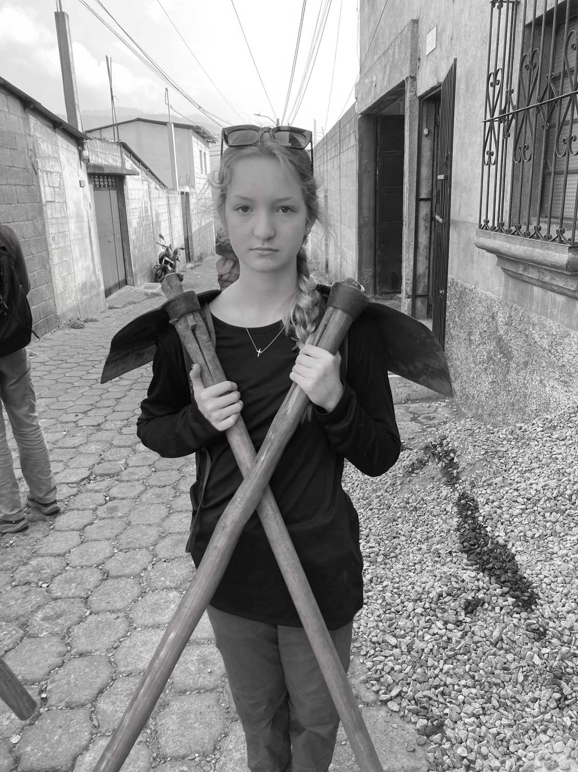
Activities, Events and Meetings: Page 3
S
Your monthly commitment to GL will be 9-12 hours
WEEKLY SERVICE PROJECTS:
YOU WILL CHOOSE THIS AT FIRST SEMINAR (Oct. 14th)
Best Buddies, Food Pantries, Intercambio, Tutoring at RMHS, PHS, Lopez, Project Heart, Shoe Drive, School Supply Drive, Shire Farm, Gardens at Spring Creek and MORE!
LUNCH MEETINGS:
Thursday before each seminar (First one: Oct. 12th)
RMHS: Room 343
PHS: Room 229
FCHS: Room M-107
FRHS: Room TBD
MONTHLY SEMINARS:
1 weekend day per month (Calendar is in your handout)
SEVERAL NIGHT MEETINGS EARLY IN YEAR!

Slide 7
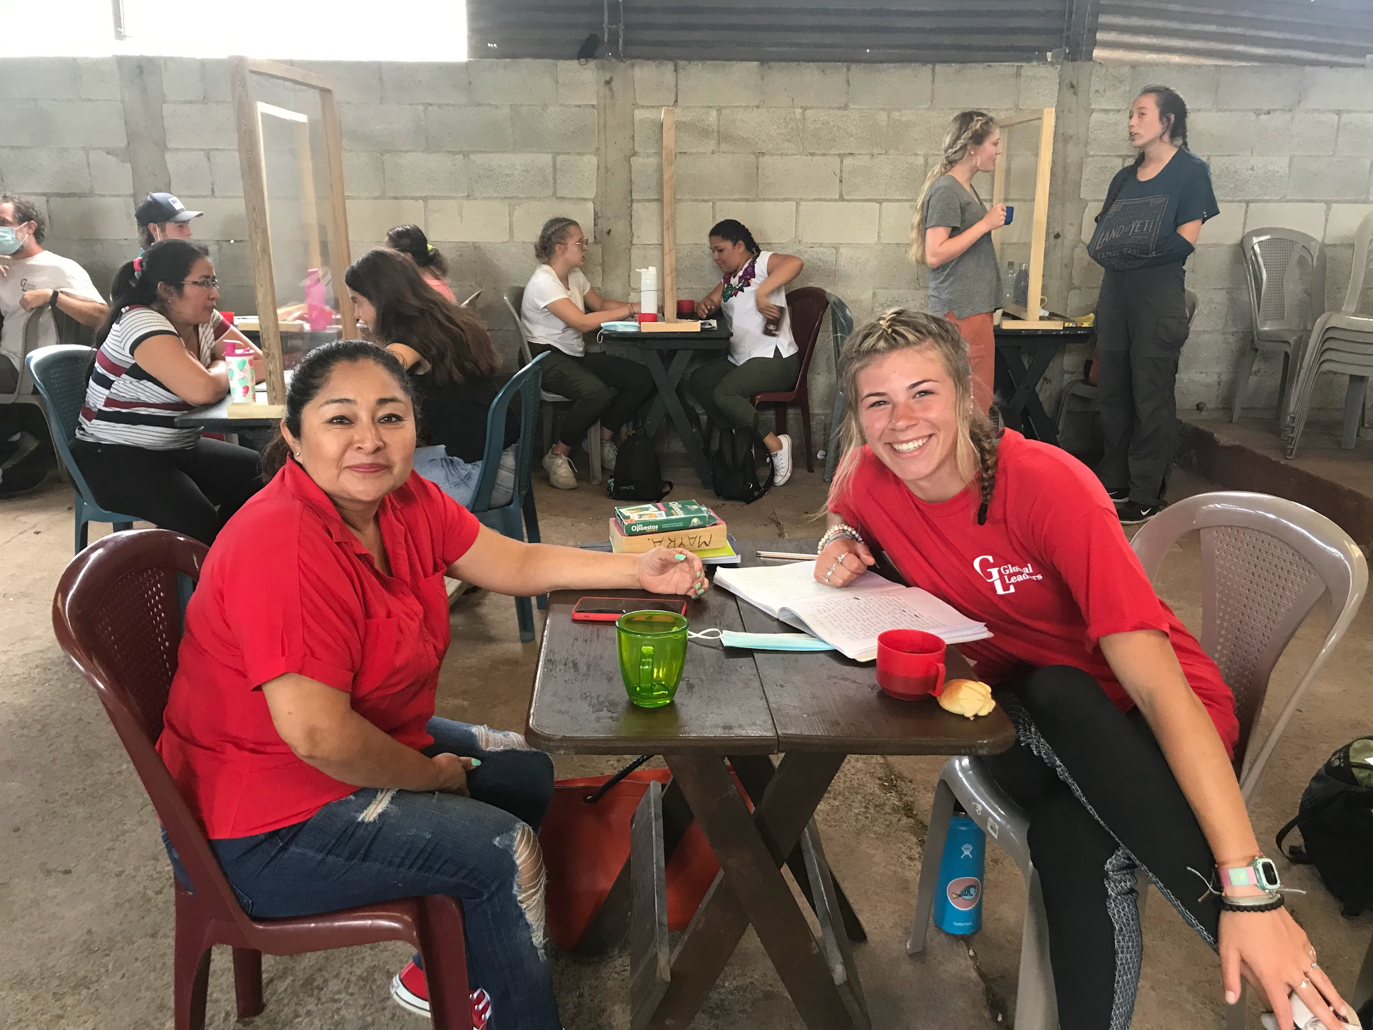
First THREE MANDATORY Dates
S
Lunch Meeting October 12th
RMHS: Room 343
PHS: Room 229
FCHS: Room M-107
FRHS: Room TBD
Saturday October 14th Leadership Seminar (FIRST SEMINAR)
Wednesday November 1st 6:30-8:30PM @ PHS (FIRST SALSA/SPANISH NIGHT)

Slide 8
Calendar: Page 4-5
S
*Expected to be at all of events on calendar.
Please communicate when life gets in the way; AS SOON AS YOU KNOW! (Minimum of 48 hrs notice) THIS MEANS A PHONE CALL (not a text) FROM YOU TO KYLA, SKYLER or JOE explaining your absence.
*Missing a seminar without proper prior communication will result in a student and GL Staff meeting about potential removal from GL.
*Missing 3 events = parent meeting and probable removal from program.

Slide 9
Dates Your Student Will Miss:
S
Scan this QR Code!
Please fill that out ASAP following this meeting

Slide 10
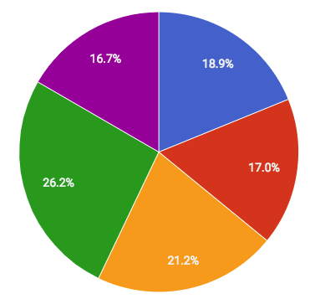
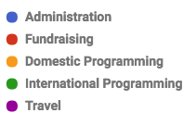
How does GL $ get distributed?
K

Slide 11
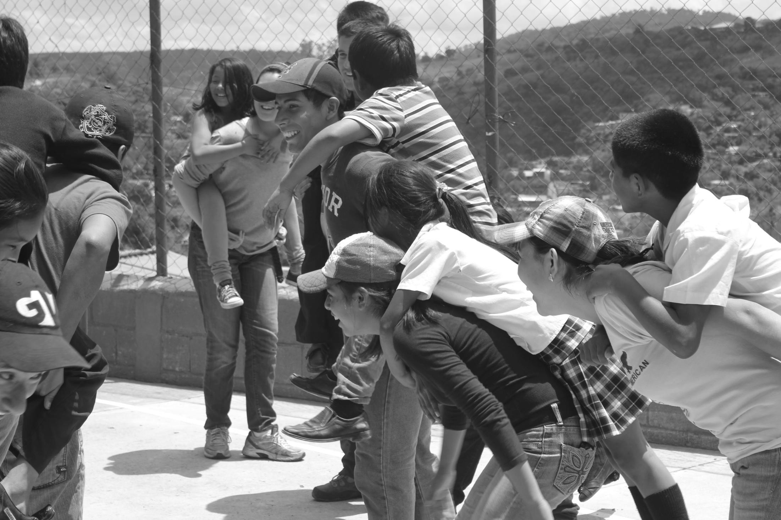
Student/Parent Fundraising Philosophy: Page 6-7
K
We are all in this together!
MOST Fundraising by full-pay students supports the project fund (local and international projects), and financial assistance for peers. Your donors will be able to choose where their donations go (projects, scholarships, or general operating costs)!
ALL fundraising by Work & Earn students goes towards their program fee.
ALL AUCTION proceeds goes to W&E, Local and International projects.
Read through packet for info for Work & Earn and full pay families.

Slide 12
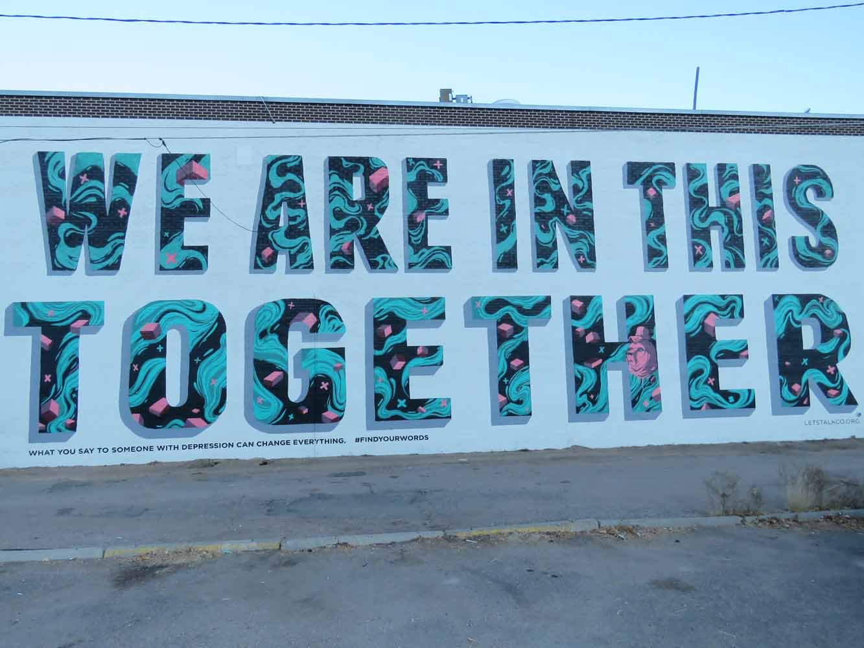
Student/Parent Fundraising Continued
What % of student fundraising gets applied to my program fee?
K
Work & Earn | Full Pay | Projects, W&E, General Operating
100% coffee sales and letters | 100% coffee sales* | 100% Auction net profits
100% King Soopers (need your documentation monthly to be able to apply to your account) | 100% King Soopers: (need your documentation monthly to be able to apply to your account) | 100% Dancing for the Stoves
100% of Auction Tix Sales

Slide 13
2022-2023 Student Fundraising TOTALS:
47 students
K
Project: | Amount Raised:
Letter writing campaign | $29,640 ($630/per student average) (average $27.39/ letter)
King Soopers | $500
Coffee Sales | $4,735
Rio Auction Ticket Sales | $9,779
Rio Auction Net Profit | $50,583
TOTAL: | $95,237

Slide 14
King Soopers page 7
**Must have King Soopers App:
Use your King Soopers account as a fundraiser!
Instructions in binder--- only takes 5 min!
GL receives 3% back every month:
This money will be applied to the Scholarship Fund
GAS purchases count too!
ALL FAMILIES selecting GL for their King Soopers receive all monies towards their program fee.
Send Kyla your monthly statement and she will apply it to your program fee***
S

Slide 15
Coffee Sales: Page 7
S
2023 GL and 2023 students bought coffee directly from Guatemalan farmers to donate to you!
Full pay students and W&E get $15/bag for all bags.

Slide 16
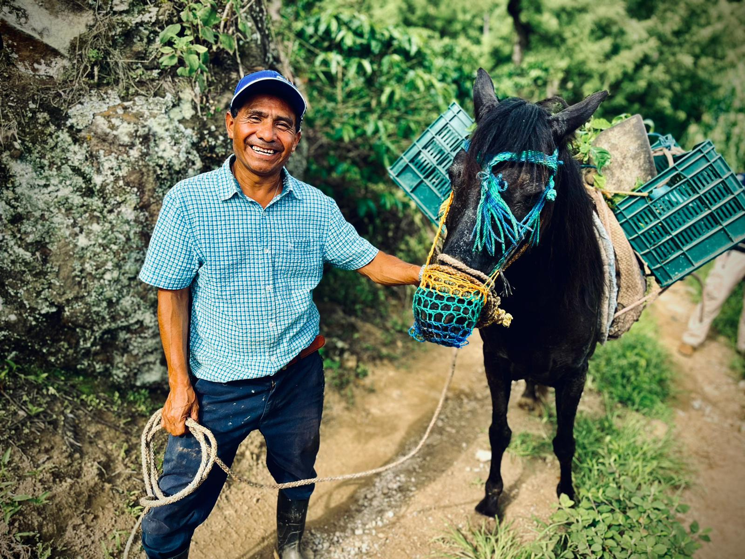
Coffee Sales continued Page 7
S
HOW? You purchase coffee for $15/bag and we credit your account “instantly”
About GL coffee!
Direct Trade, shade grown, supports small Guatemalan farmers, like Alberto!
Whole Bean and Ground Medium Roast… DELICIOUS!

Slide 17
Letter Writing Campaign
Sample Letters: pages 8-11
Pages 8-9: FULL PAY FAMILIES: Letter asks for donations for scholarships and projects
Pages 10-11: WORK & EARN FAMILIES: Letter asks for support for your program fee
IS YOUR LAST NAME WRITTEN ON SMALL ENVELOPES BACK LEFT CORNER? DO IT NOW!!

Slide 18
Letter Writing Campaign STARTS NOW:
(Take a picture of me… this slide)
Brainstorm list of 23 people or businesses you have a relationship with (family, out of town relatives/friends) (not Elon Musk or other people in this room)
Write the donor’s name next to the word “Dear…”
Put a heartfelt handwritten note on each letter in the “personal note” section.
Sign your letter with a pen
Fold letters and put in bigger envelope
Address big envelopes: PARENTS PLEASE HELP THEM WITH THIS
DO NOT SEAL THE ENVELOPES - we check before sending
Bring completed letters to first seminar… or we will come by schools on Oct. 19th at lunch, or you drop it at our office!)

Slide 19
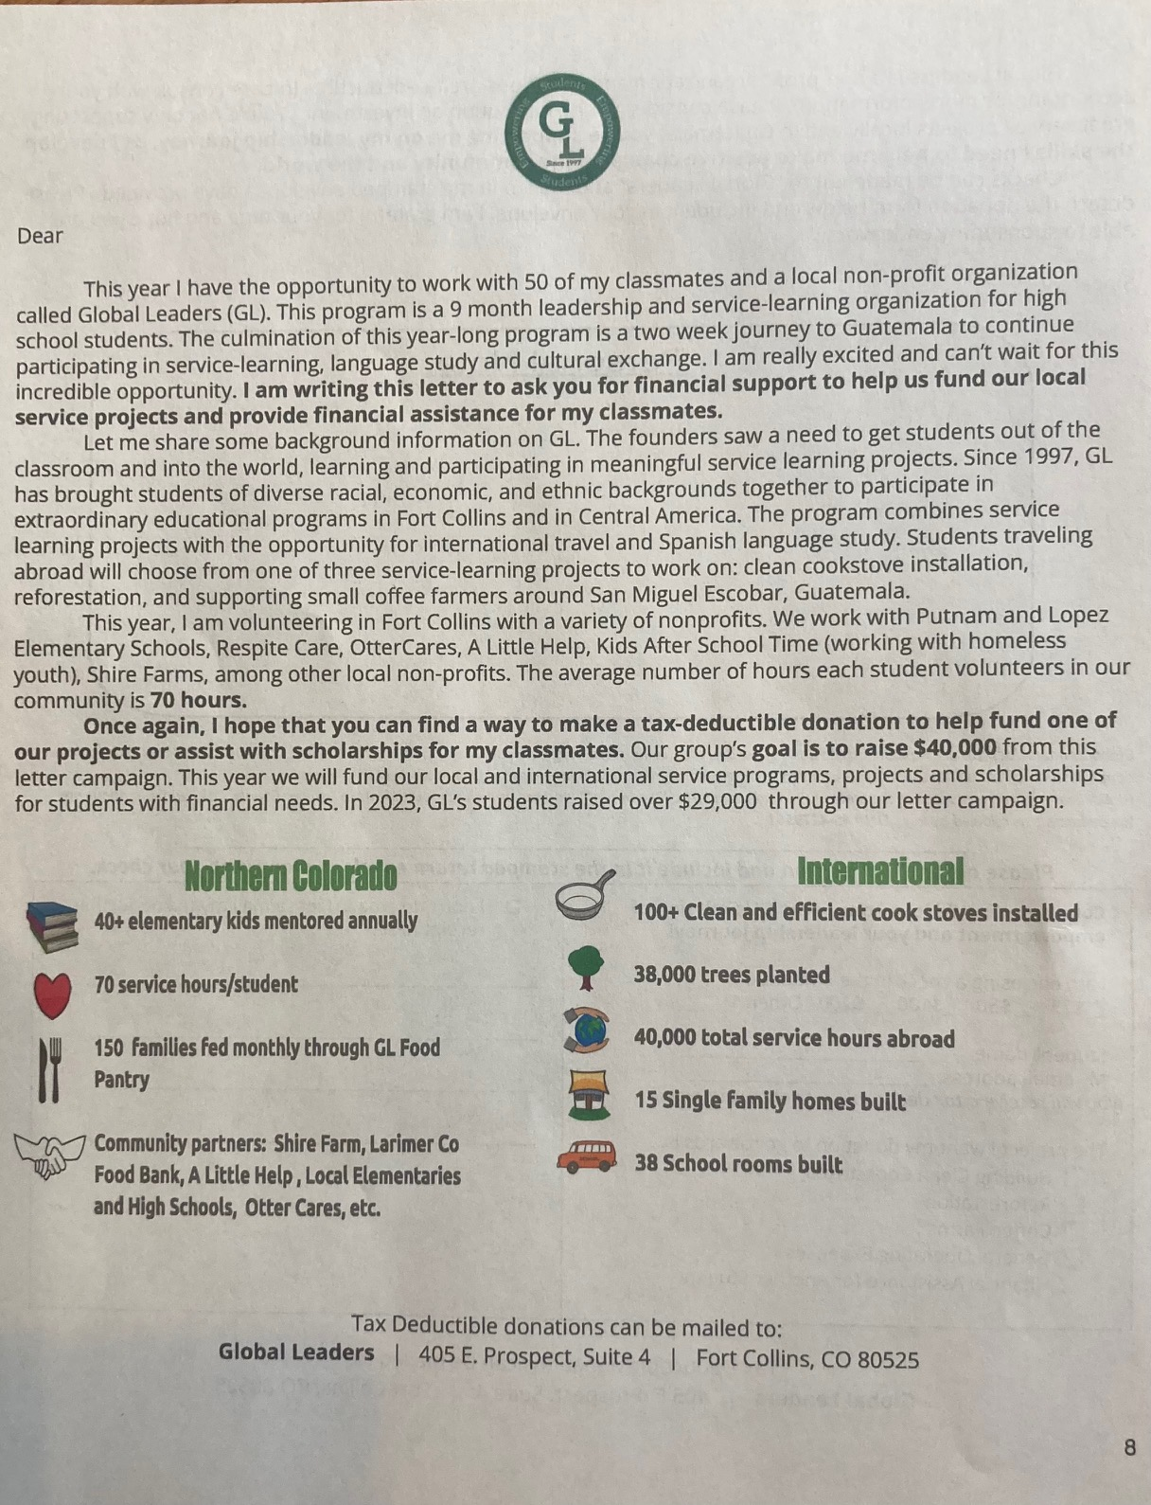
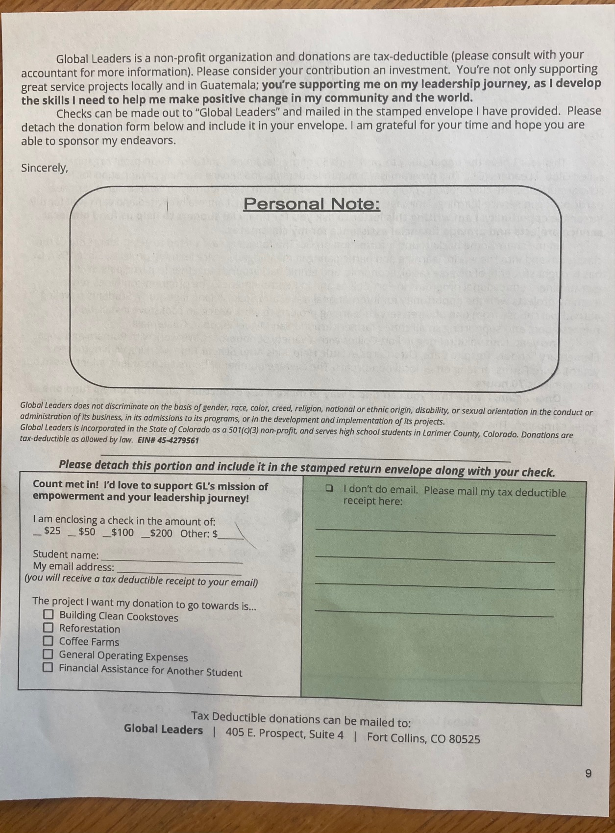

Slide 20
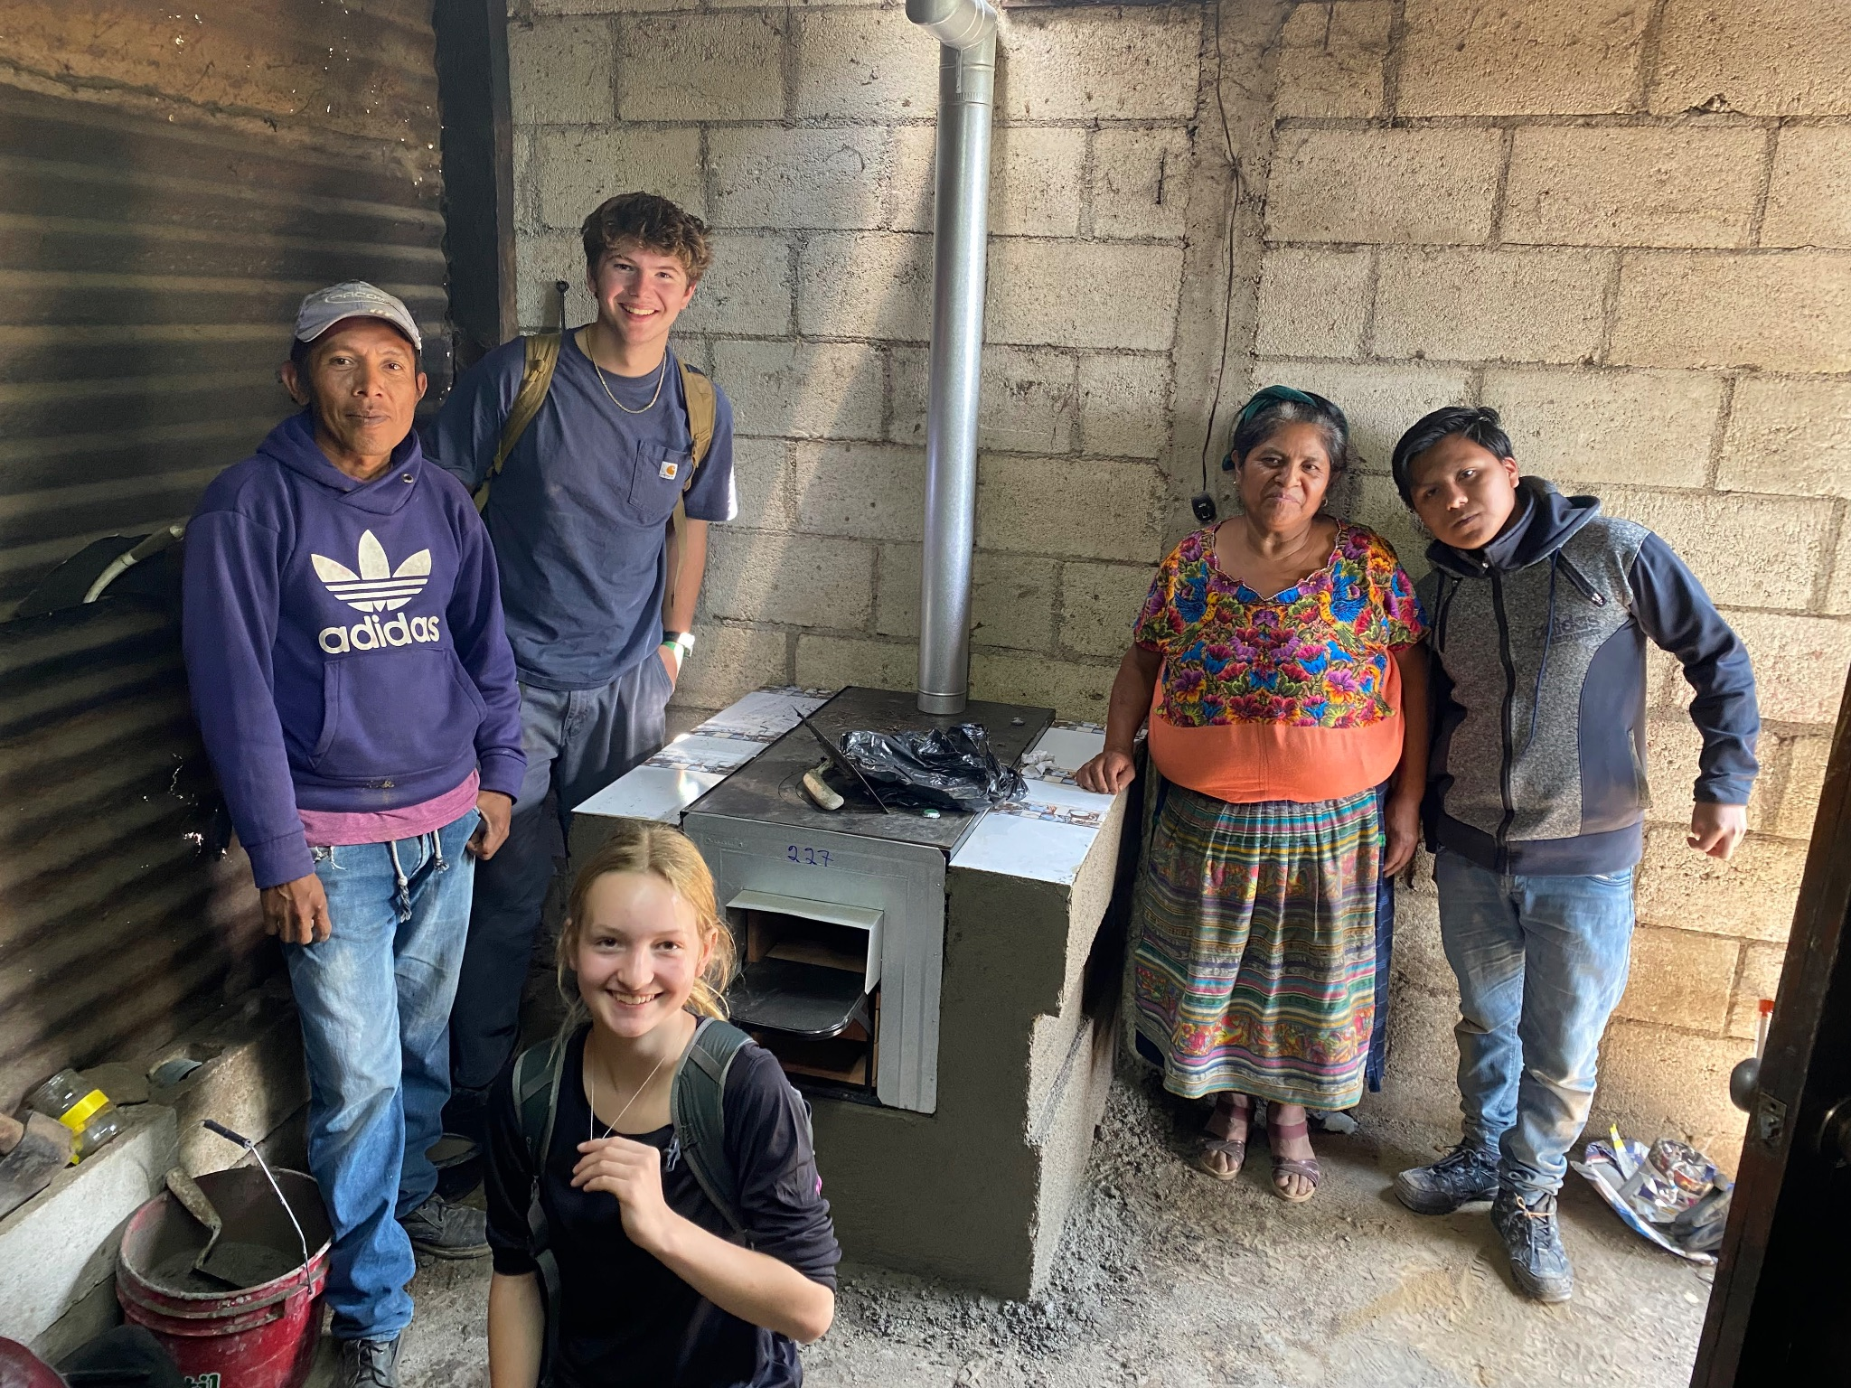
“Dancing for the Stoves!”
LL
A night(s) to raise $ for 50 cook stoves!
($205/stove w/ installation = $10,250)
Salsa and Merengue lessons for GL parents and friends at the Rio!

Slide 21
Fiesta de Global Leaders
Rio Grande Benefit Auction: Page 12
M
This year April 20th, 2024
Most lucrative fundraiser: $50,583.06 NET 2023
GL planned and executed
Student hosted: sponsorships, ticket sales, item procurement, event management
ITEM WISH LIST IS IN YOUR FOLDER POCKET
Parents support: item procurement, sponsorship and event set-up
Think of people you know that can donate items, large and small (Vacation homes, art, landscaping, experiences, packages, etc.)
Donations/sponsorships are tax deductible
Invitees are those that are willing to spend – if they are there, we want them bidding.

Slide 22
Donations for the Auction
S
HARD COPY IS IN THE FOLDER OF YOUR HANDBOOK
Vacation Homes, timeshares, airline miles
KAT REEVES BISTRO NAUTILE Donation
Sports or experience tickets: Broncos, Rockies, Brewery/Wine tours, Dinners
Gift baskets – collections of similar goods
SERVICES: Massage/Spa services
A car!
Food/dining certificates
Household and utility services- yard aerations, roofing, sprinkler blowouts etc
Vet and doctor/dentist visits
Retail items – jewelry and crafts

Slide 23
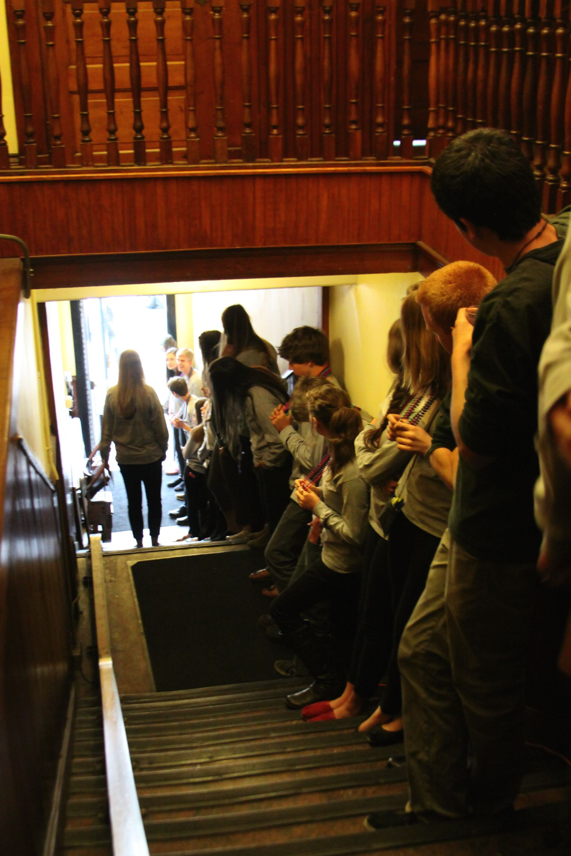
Committees/ Parent Involvement: Page 12
S
Auction Meeting:
Wednesday, November 29th
LOCATION: PHS: 6pm-7pm
3 TEAMS:
Procurement of items
2. Sponsorships ($50-$5,000 or more)
3. Logistics

Slide 24
2023-2024 Student Fundraising Goal
K
Letters ($600 per student x 64 = $38,400) (some exec not writing letters)
Coffee Net sales ($6,000)
Auction Tix Sales ($10,000)
Global Leaders: “Dancing for the Stoves” ($5,000)
NET AUCTION Profit ($55,000)
King Soopers ($700)
Goal: $115,100

Slide 25
Work & Earn Program: pages 15-16
K
You will receive your W&E award letter by October 20th if we receive all request forms by Tuesday October 17th
Parents, if needed, Kyla will schedule a phone call with you after we receive your request form
All awards are coupled with Work & Earn hours- CHAT WITH Kyla
Typically (but not always) the maximum award is 50% program fee + airfare
The remaining balance is your responsibility:
Total Program Fee = Family Payments + Work & Earn Award + Student Fundraising
The family payment and Work & Earn agreement made at the beginning of the year will not change based on fundraising

Slide 26
Signed Participant Agreement:
You should have signed and turned this in at check-in
We need this signed and turned in tonight
J
Students + BOTH parents or guardians (if available) must sign our Participation Agreement

Slide 27
Remind Texts!
S
Send a text to 81010:
ALL students text this message to join: @gl20232
ALL parents text this message to join:
@glparen

Slide 28
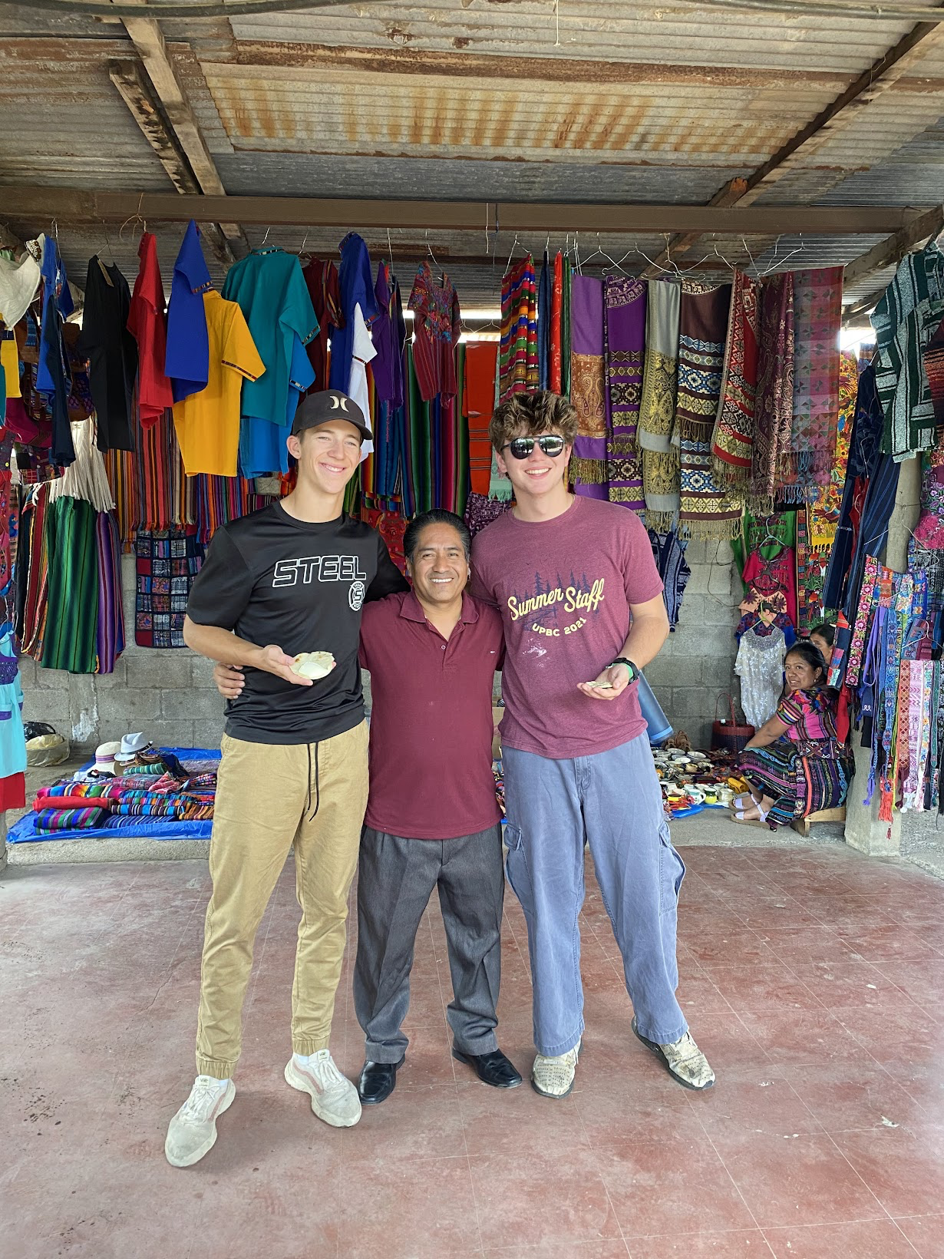
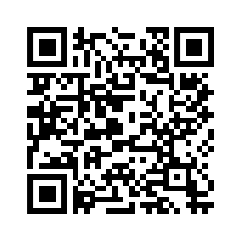
Parent Volunteers for carpools to Saturday/ Sunday Seminars
S

Slide 29
Add Us On Instagram + Facebook
Instagram: globalleadersinc
Facebook: Global Leaders

Slide 30
LUNCH MEETING AND SEMINAR
Thursday Oct. 12th Lunch Mtg
PHS Room 229 RMHS Room 343
FCHS M-107 FRHS Room TBD
SEMINAR Sat. October 14th 9am-3pm
Salsa and Spanish Wed. Nov. 1st 6:30pm-8:30pm

Slide 31
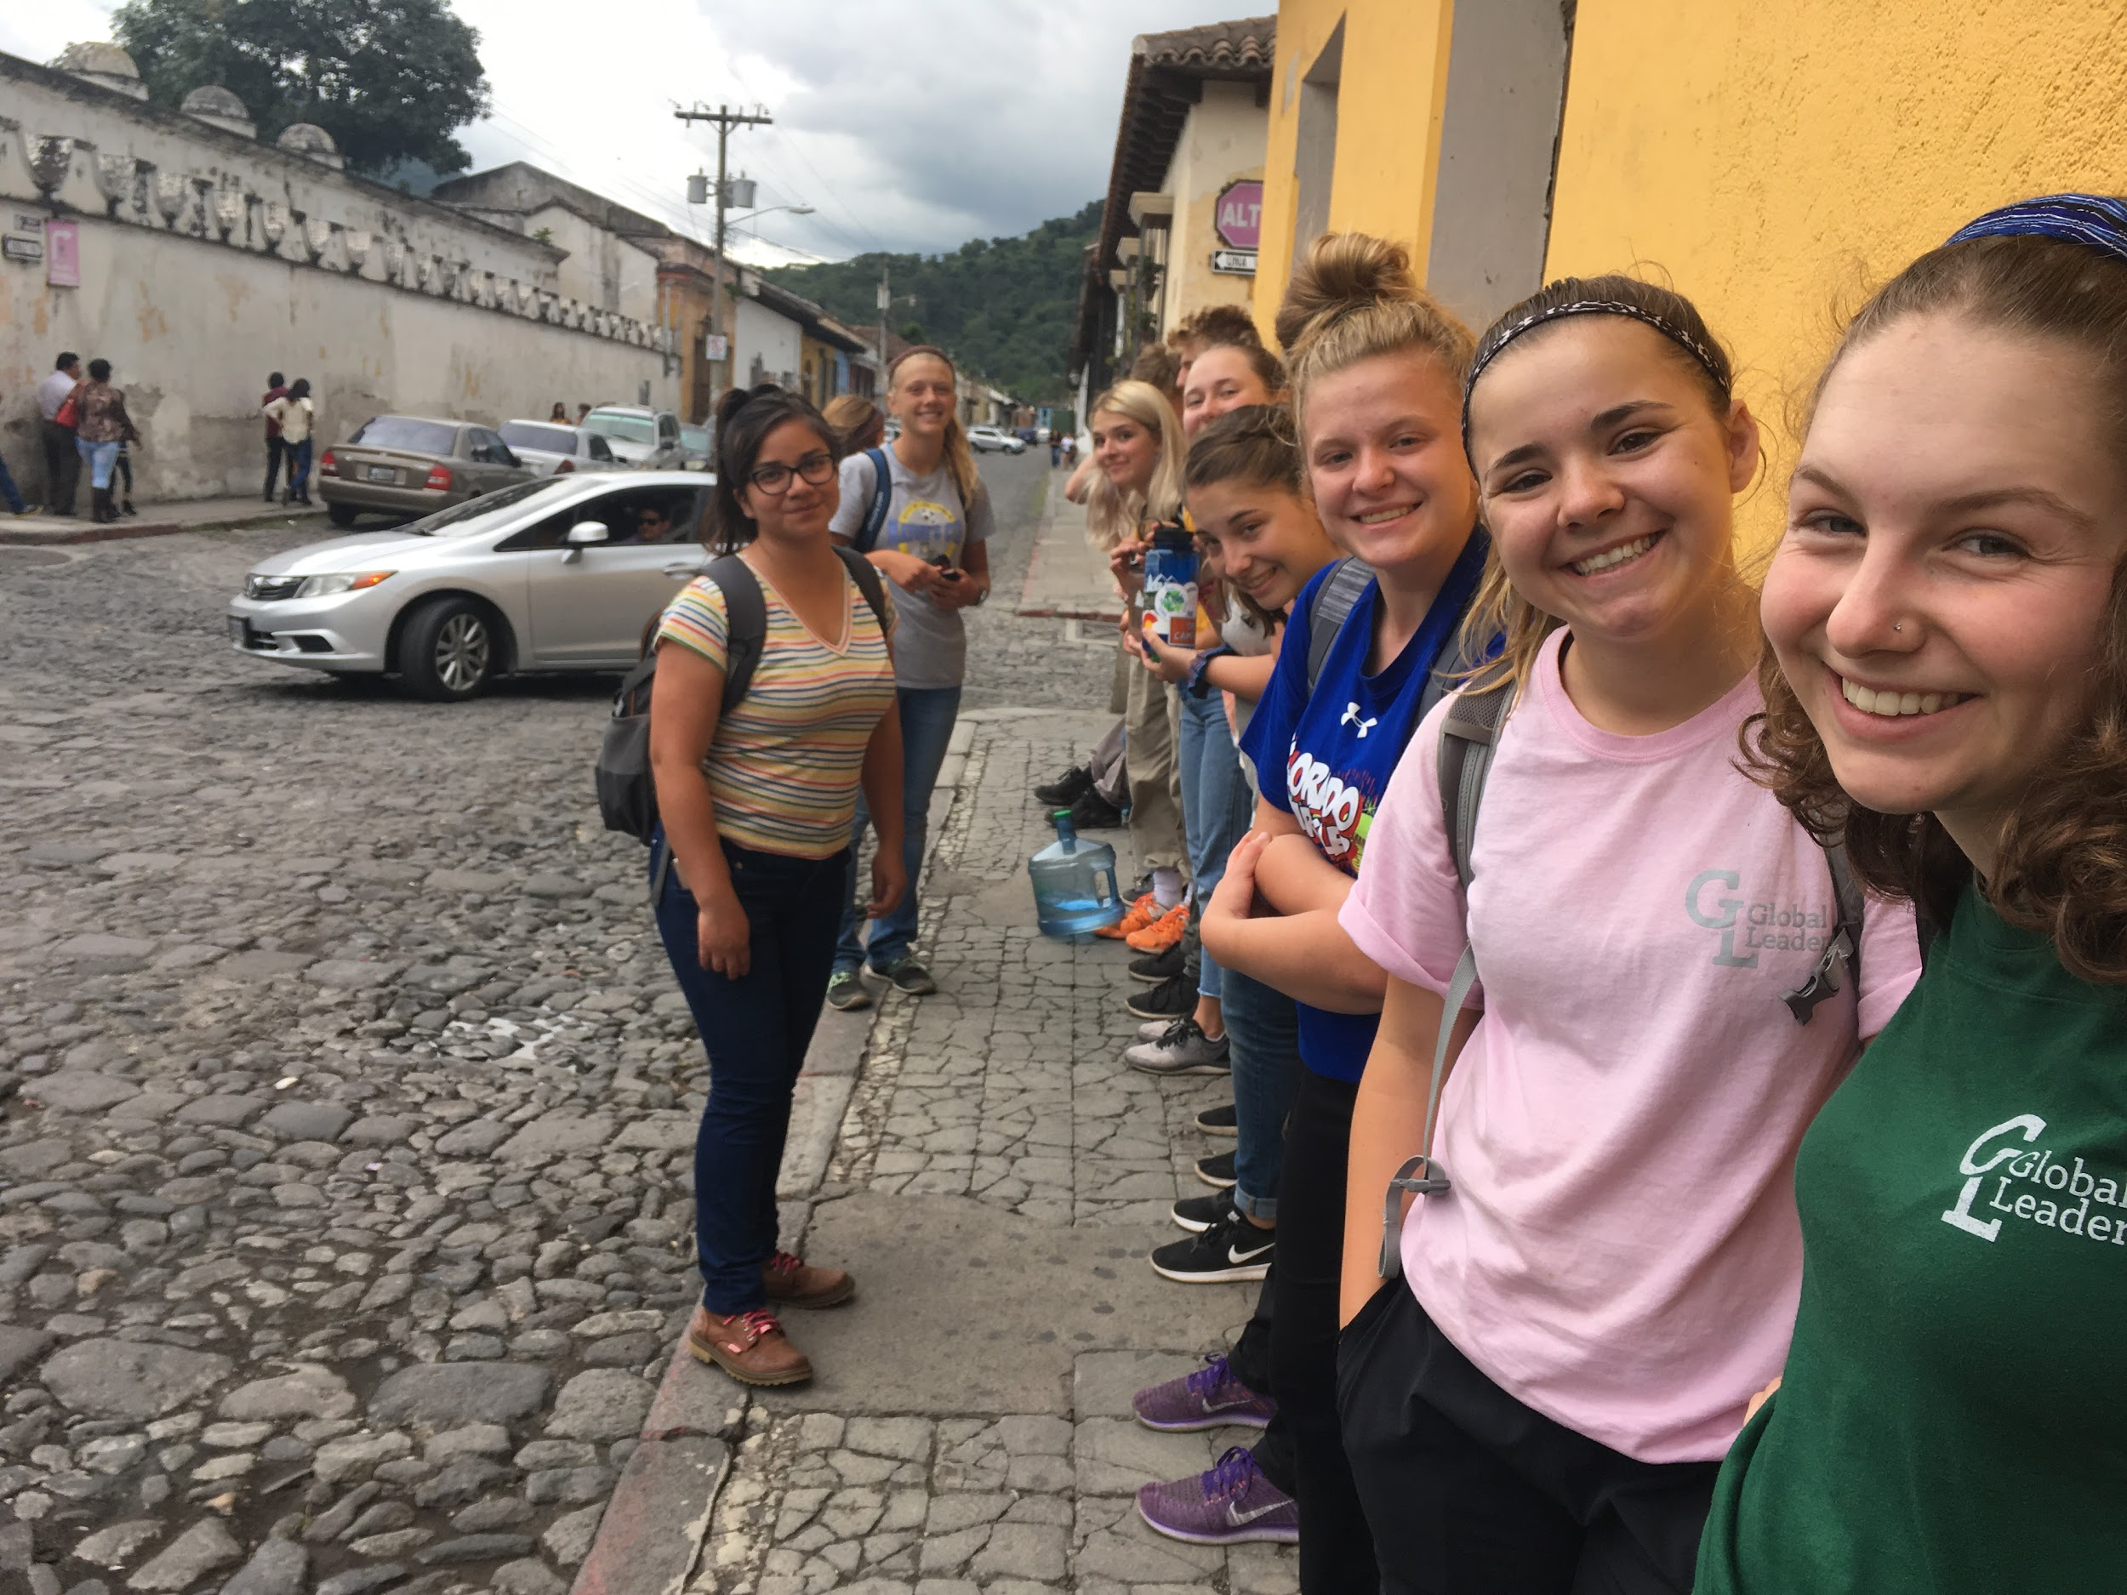
June and July numbers:
June: 27 students
July: 19 students
Need 3-5 students to move to July
Preference will be given to
recently graduated seniors

Slide 32
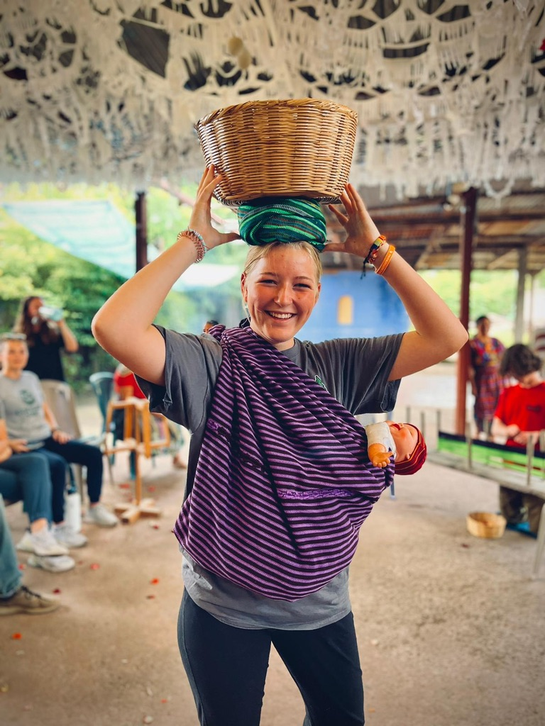
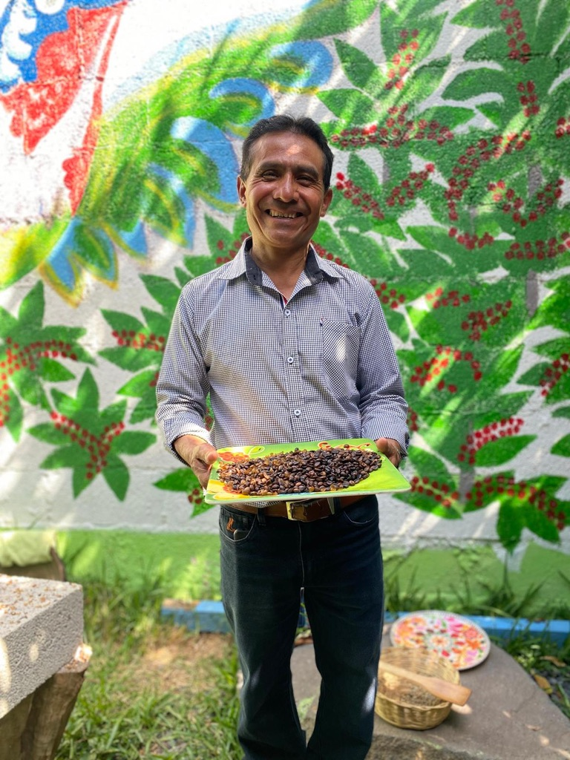
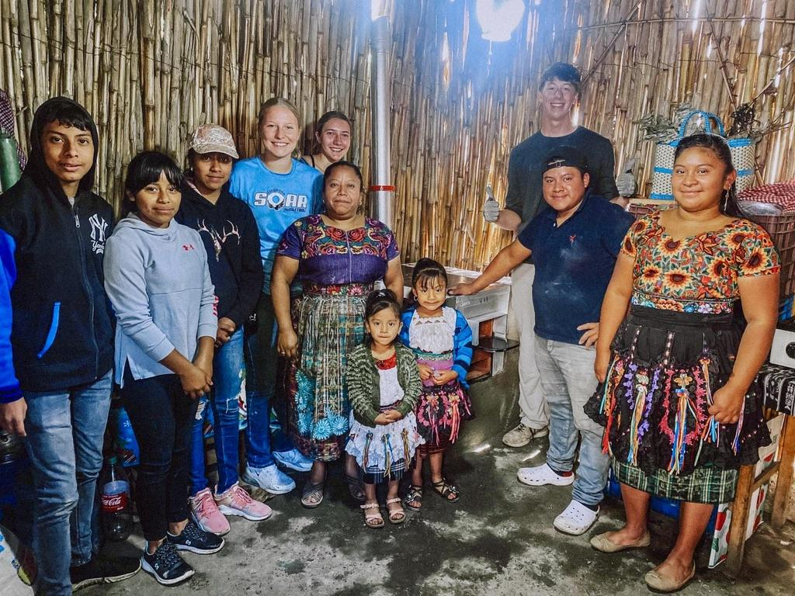
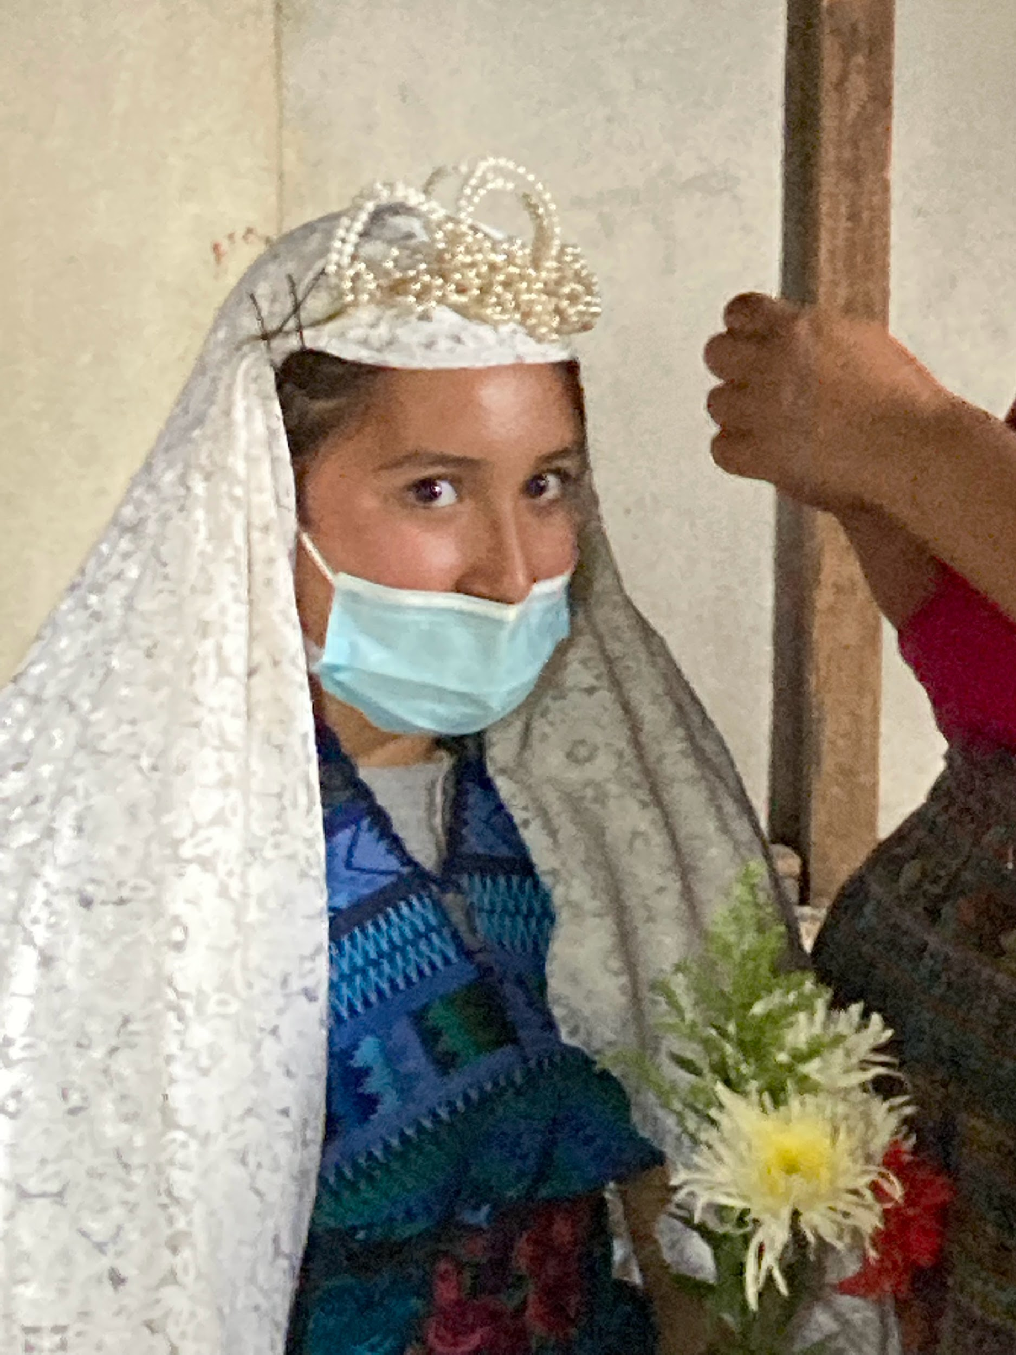
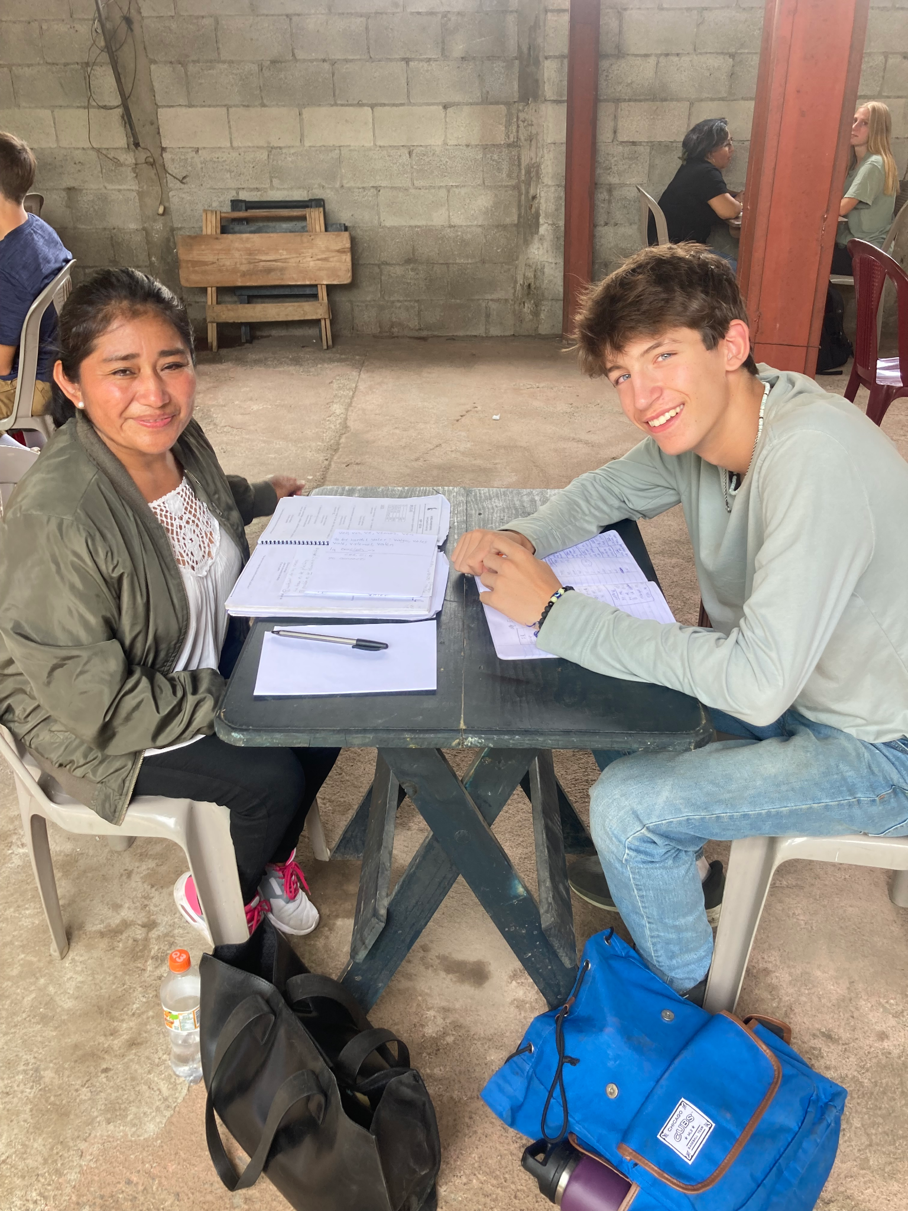
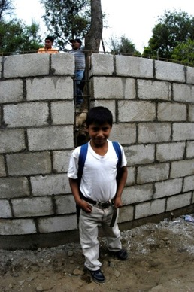
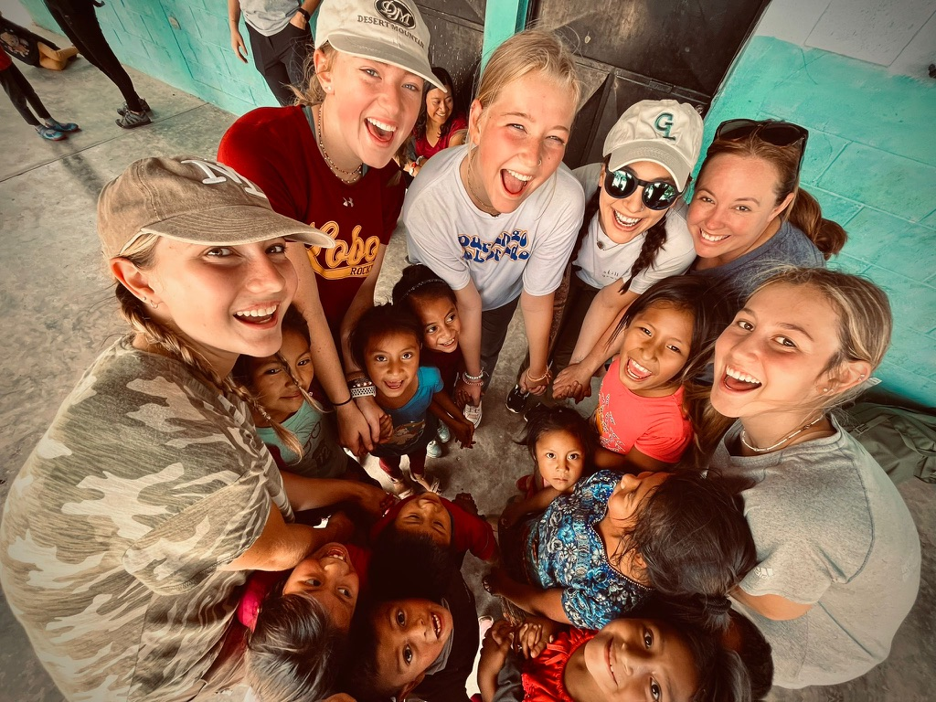
Questions?

Slide 33
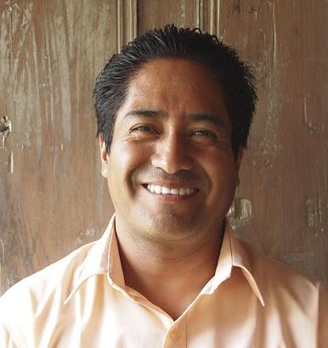
Meet:
Aurelio “Houston” Hernandez

