Slide 1
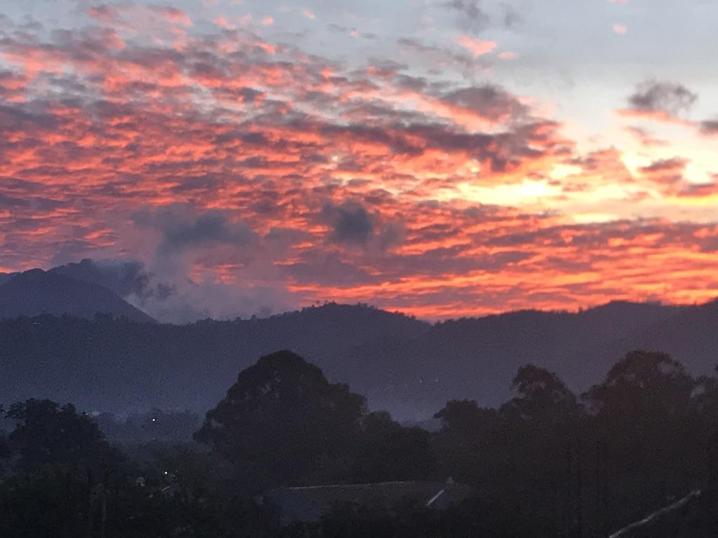
https://vimeo.com/356293927/72a3e61ed5
We are Global Leaders ....
Welcome to the Global Leaders Team!

Slide 2
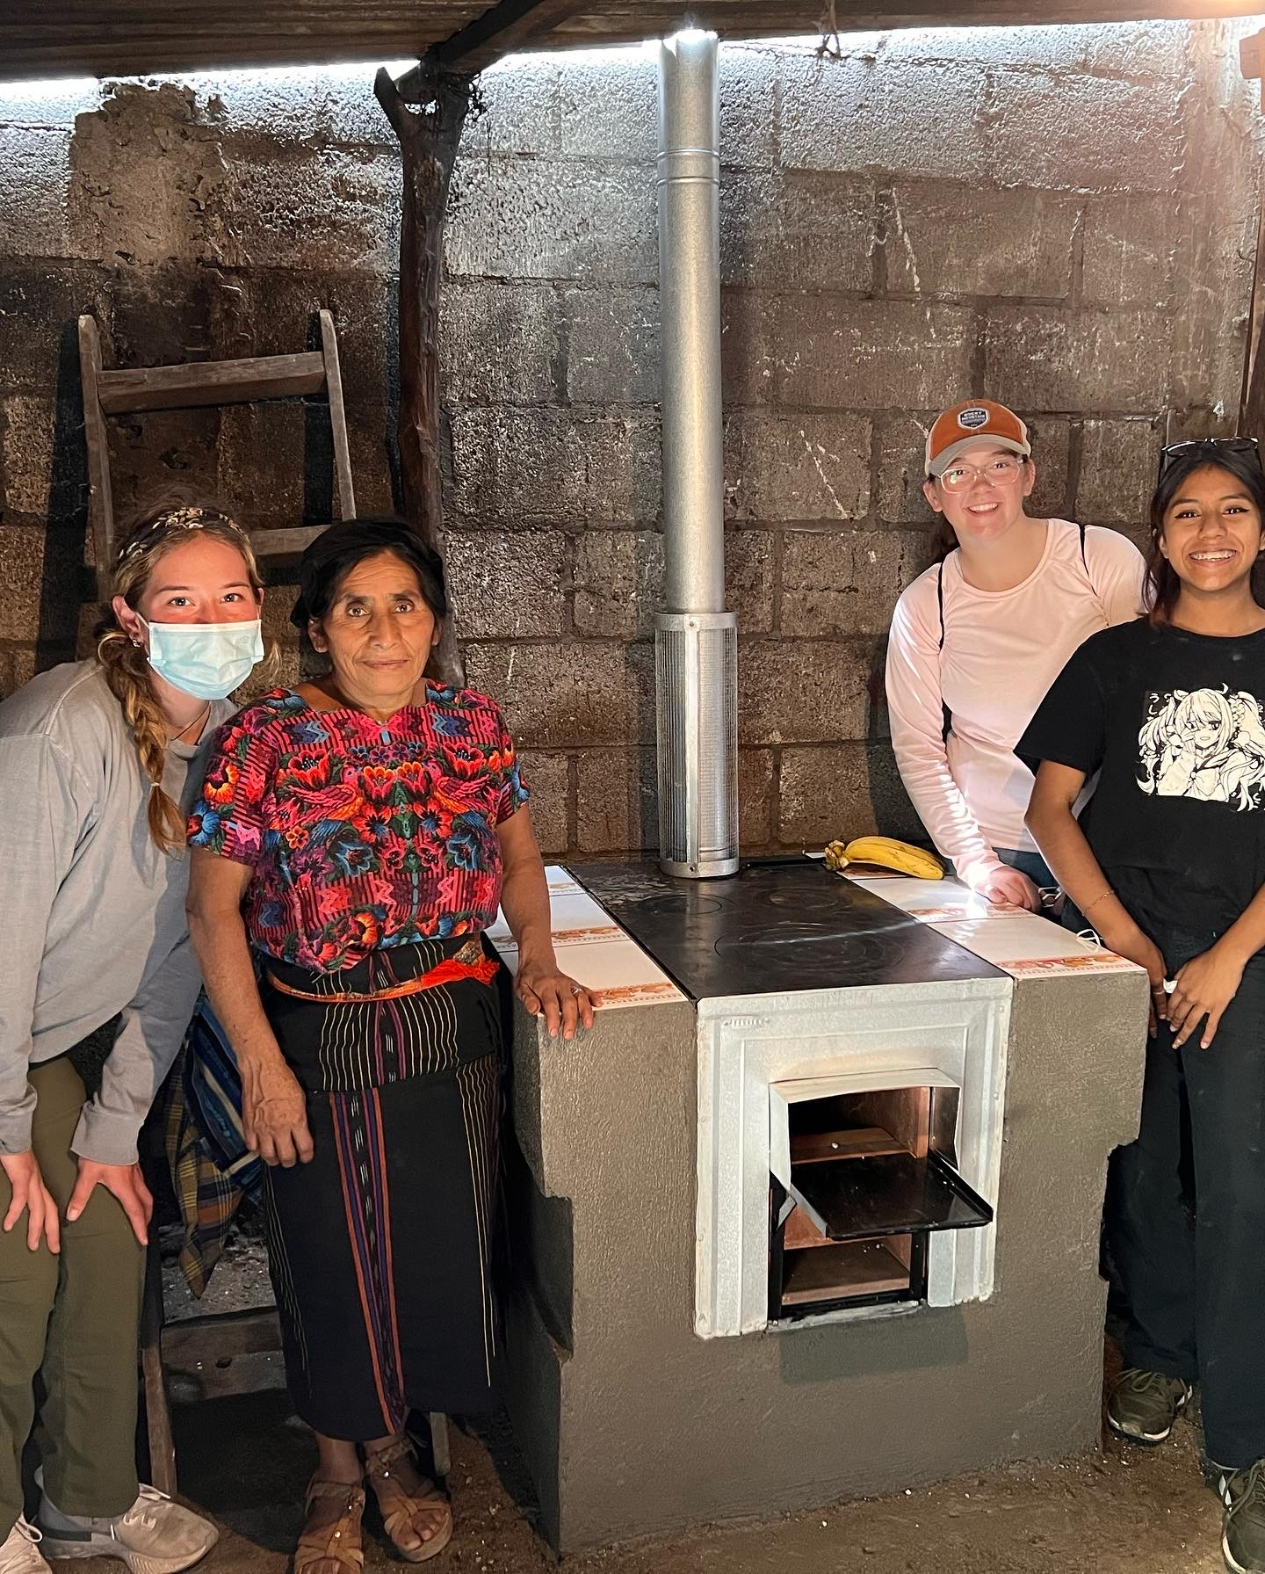
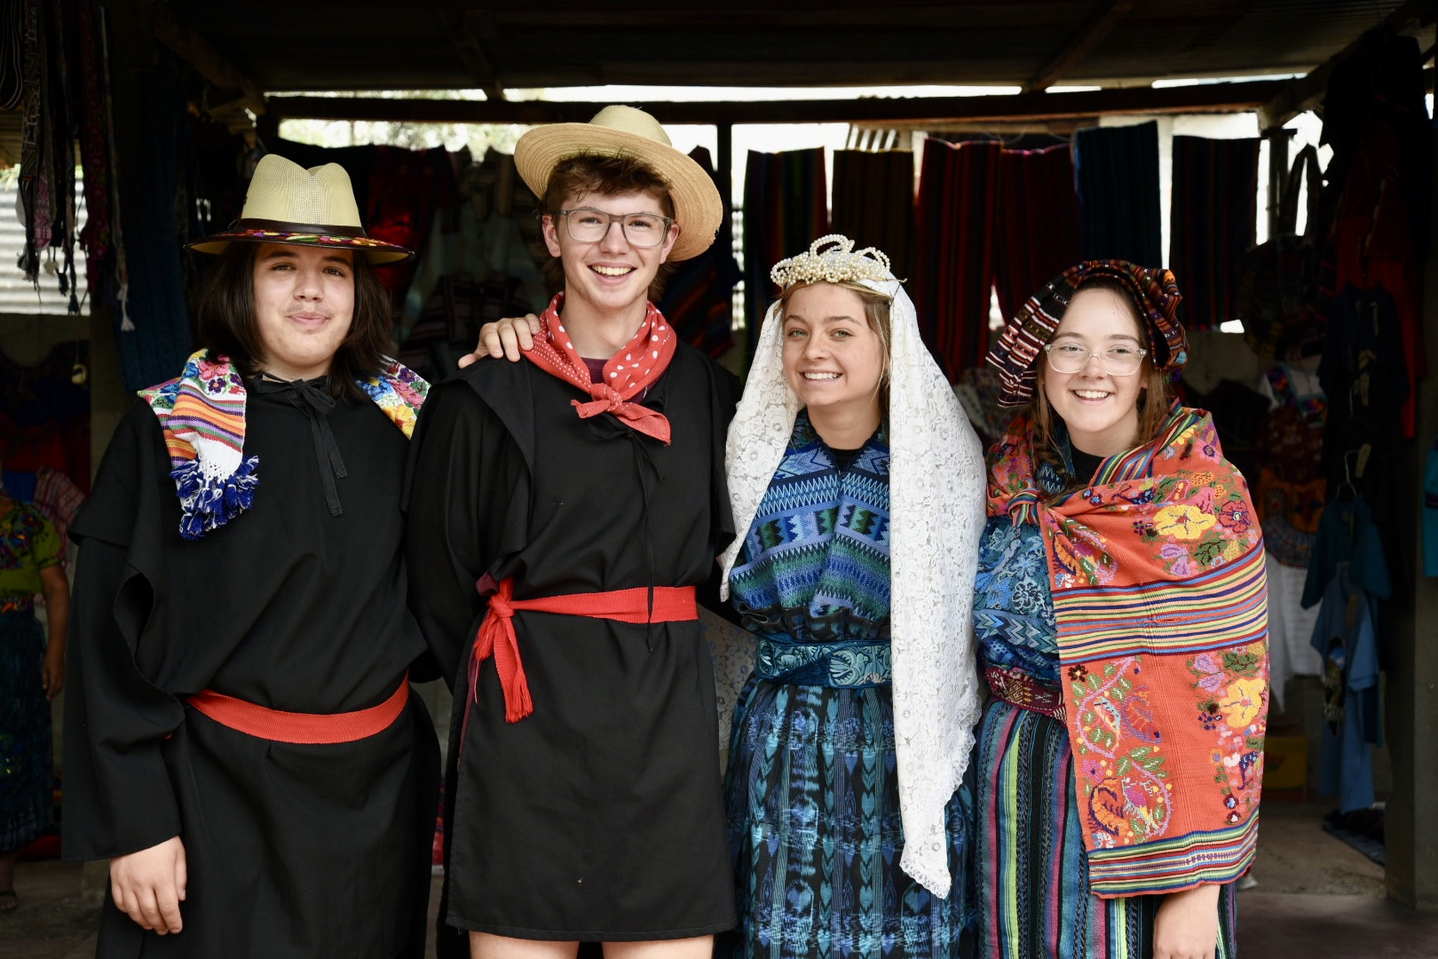
This is our mission, we are committed to giving young people opportunities to “see” issues in communities and train them to work towards positive change.

Slide 3
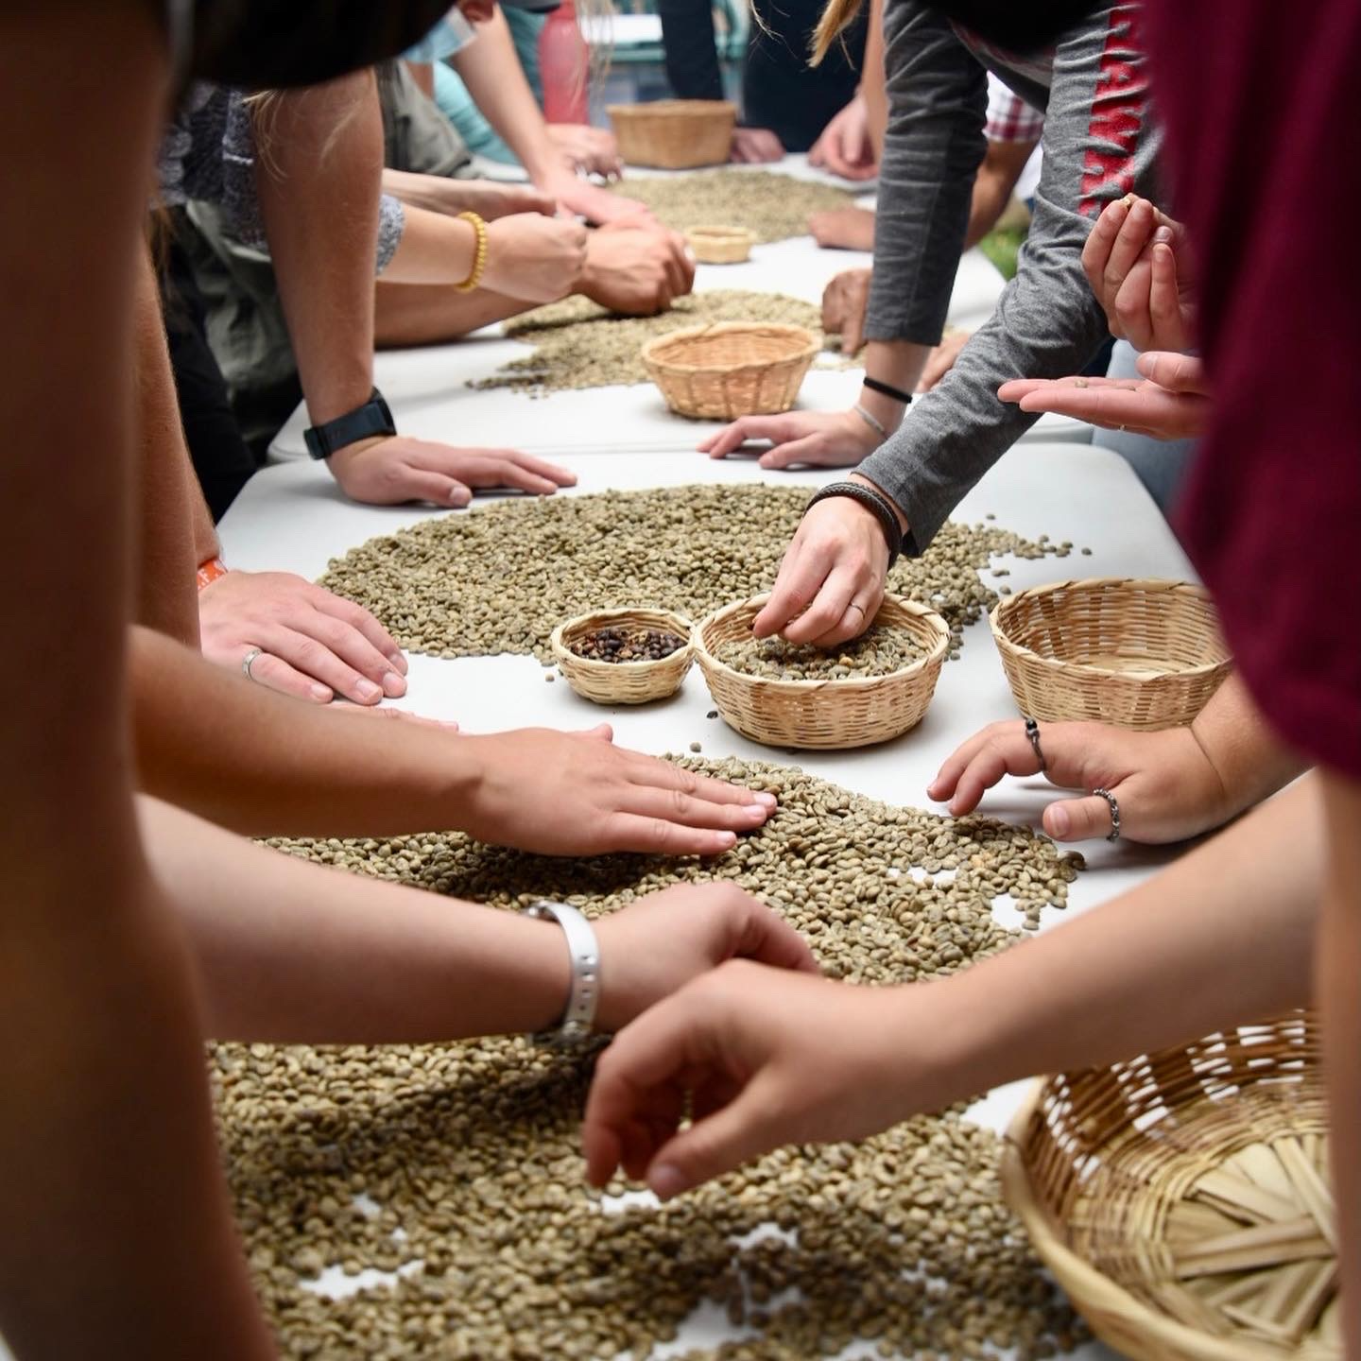
“Saviors” of any kind…. These are groups that believe people and countries are needing to be saved.
This is a consistent discussion within Global Leaders.
Our “WHY” has to align with what is best for the communities in where we work.
We’ve had failures in this realm… (an example)
Shoe Distribution till 2015
Who we try not to be…

Slide 4
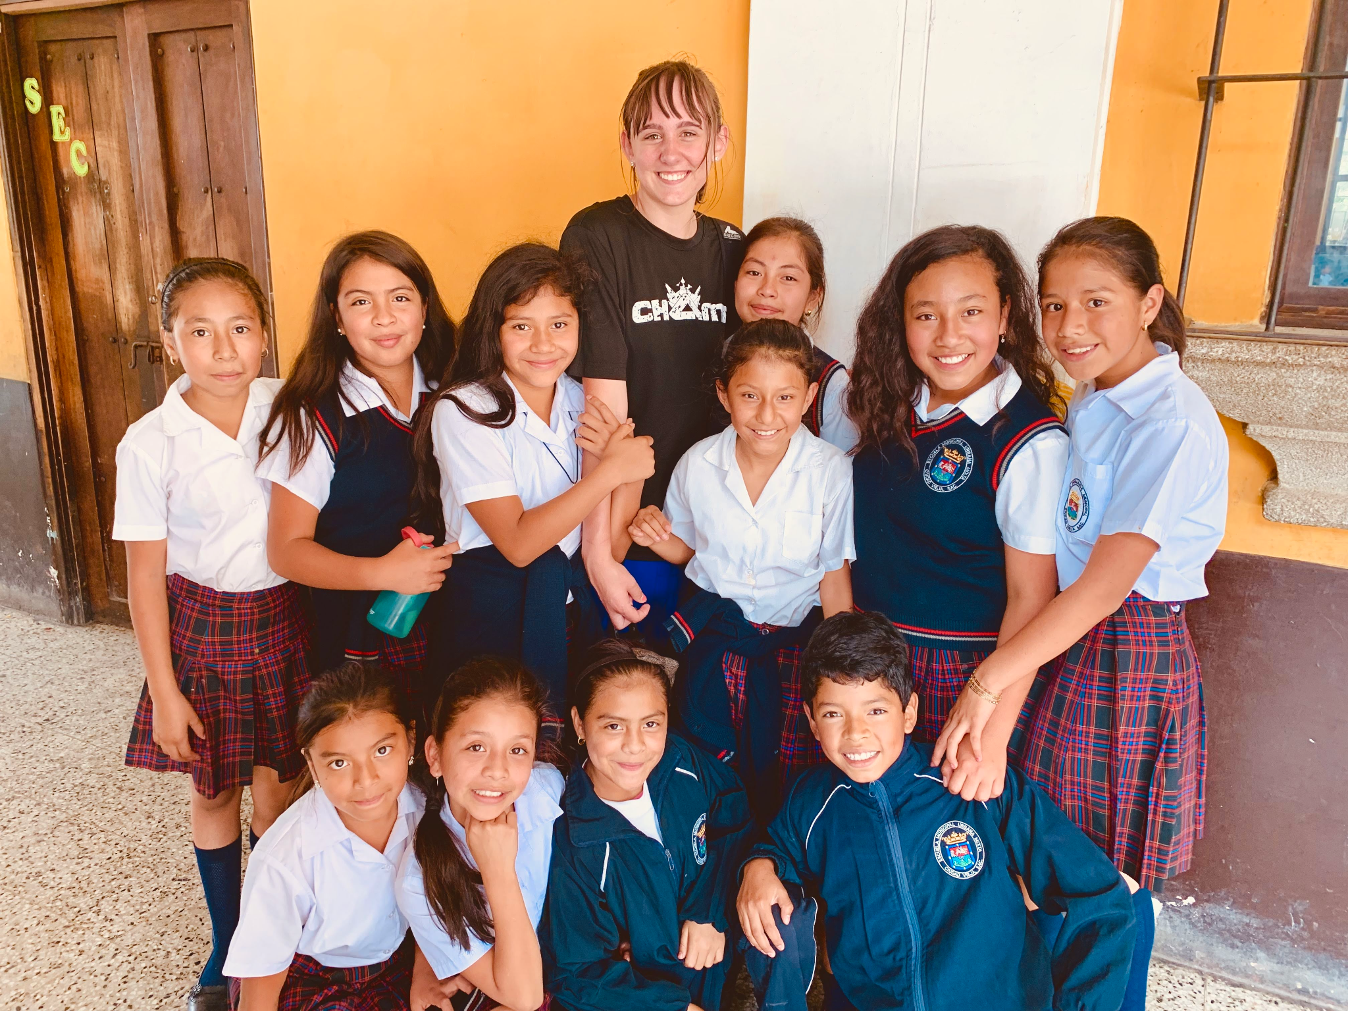
Service-Learning, Leadership Training, Cultural Exchange opportunities!
EVERY PROJECT WE TAKE ON LOCALLY AND INTERNATIONALLY IS DRIVEN BY THOSE AFFECTED… WE WORK WITH NOT FOR COMMUNITIES
Who we try to be… We make every effort to be an organization that empowers young people to take action for positive change by providing…

Slide 5
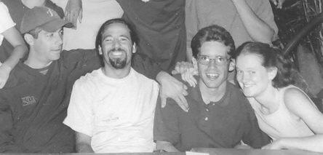
HISTORY
GL has taken 34 trips and over 1300 students to Guatemala, Costa Rica, Tonga, Ghana, and the US Southwest.
2023
GL was established by Jason Foster, Chris and Joe Fontana.
1997

Slide 6
MAKE A MOVEMENT
We guide YOU to implement positive change through John Maxwell’s process of the 5M’s:
MODEL
MENTOR
MONITOR
MOTIVATE
Watch us!
Let’s do it together!
You do it, I’ll help!
MULTIPLY
Yes, YOU can do it!
Now go teach others!
Notes:
Global Leaders is educational in that we develop and train leaders to conceptualize, plan & implement positive systemic change through service to our communities. We guide our students through John Maxwell’s process of the 5M’s: Modeling (Watch us!), Mentoring (Let’s do it together!), Monitoring (You do it, I’ll help!), Motivating (Yes, YOU can do it!), and Multiplying (Now go teach others!). This prepares students to not only create positive change by themselves but to teach and empower others by multiplying their effect. This method prepares, equips and builds leaders for many future careers or situations in which they will lead others. Each student participates in an intensive leadership training.

Slide 7
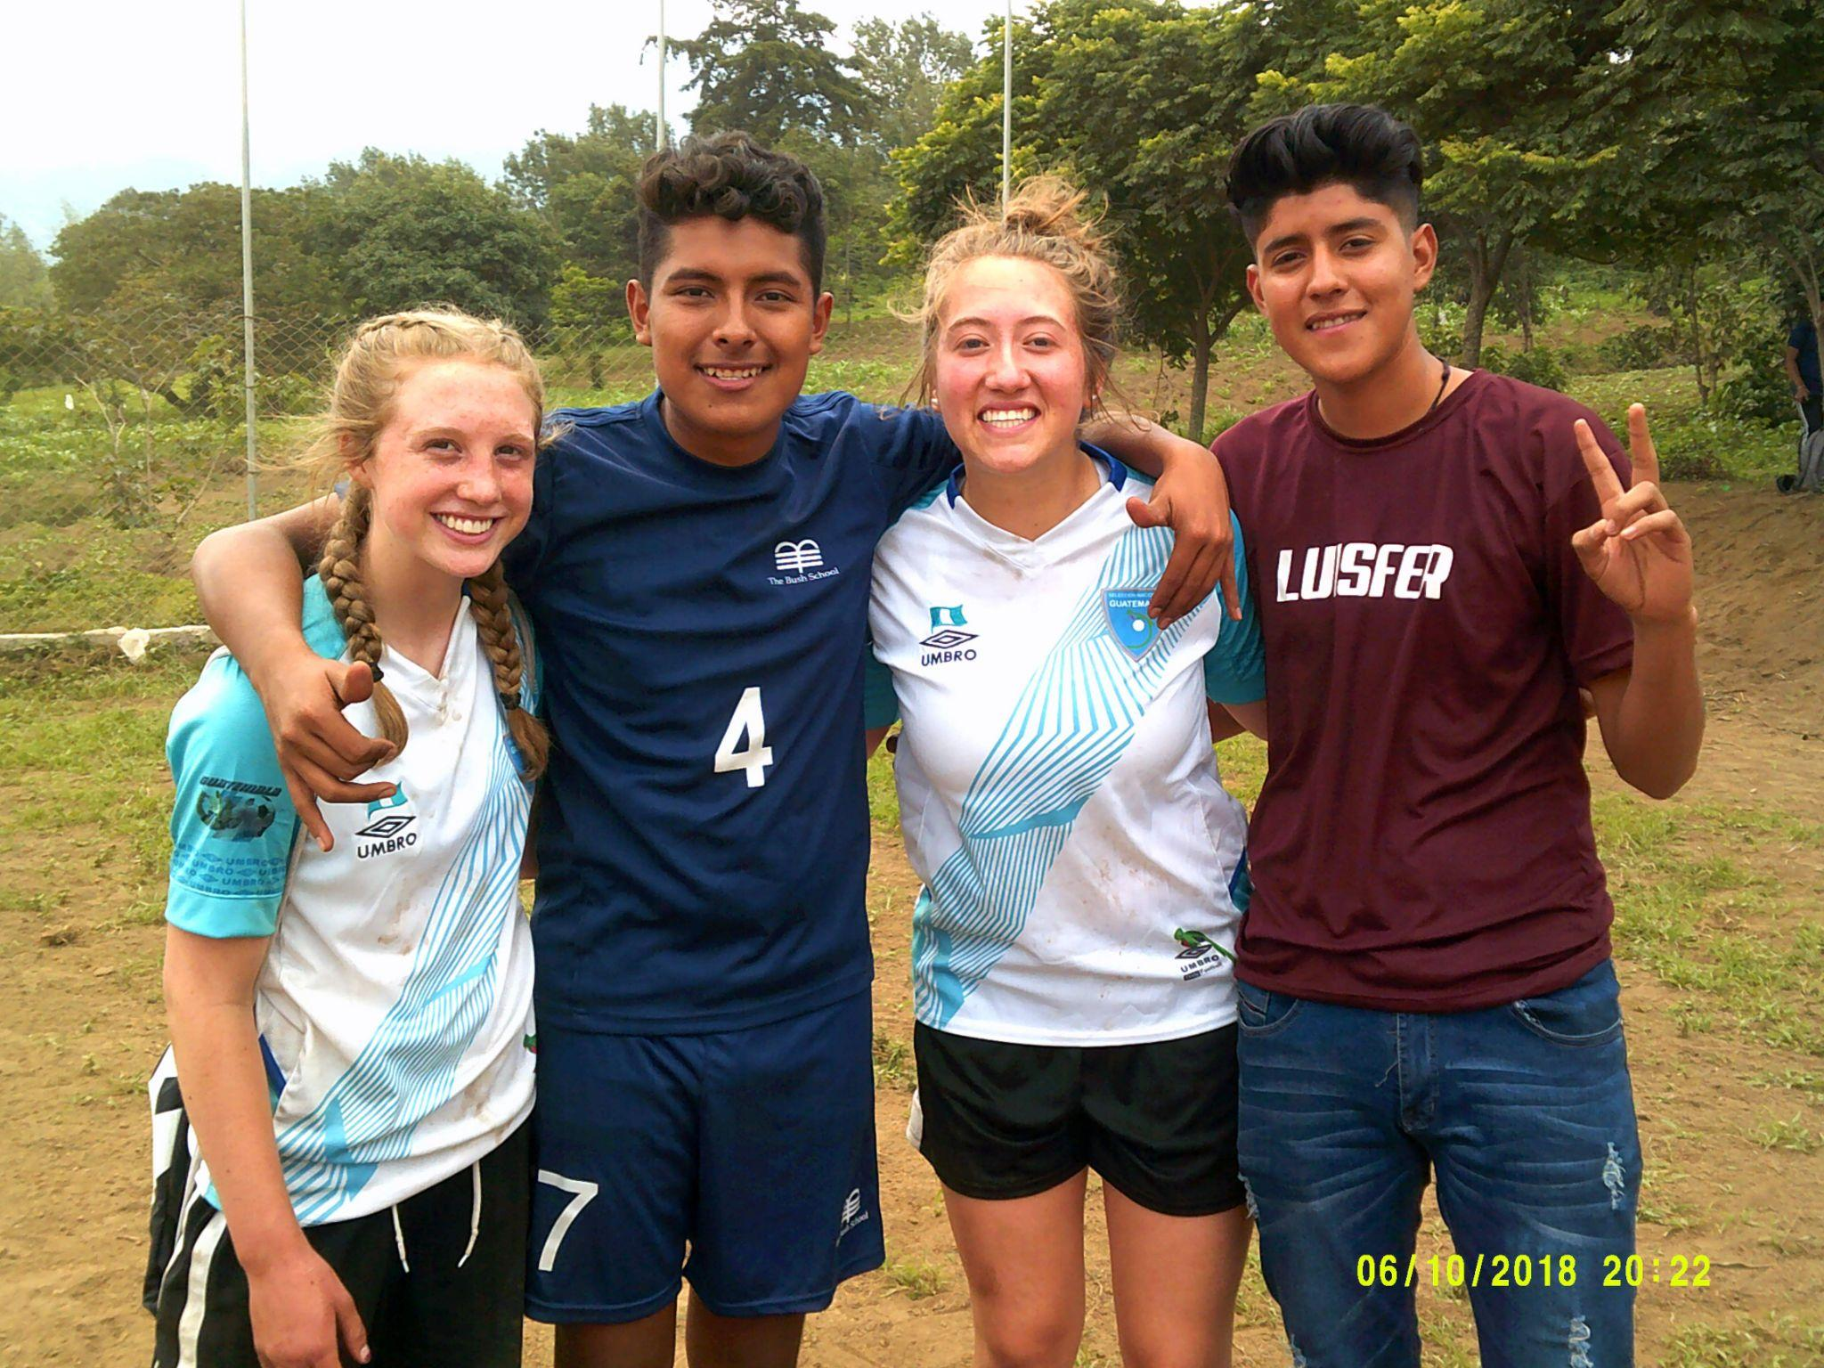
THE
DIFFERENCE
Established in 1997
Staff has roots in public education
Local service & leadership training
Local & international projects funded by GL
International student leadership training + language skills
Dedicated to including students from low income families
We work alongside Guatemalan HS students

Slide 8
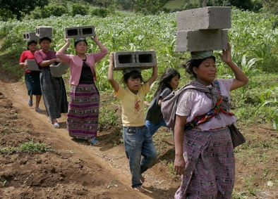
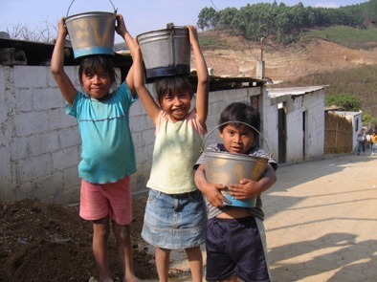
SERVICE STATS: Since 1997
Guatemala:
*38 Schoolrooms built
*60 Clean cookstoves
*38,000 trees planted
*15 single family (portable) homes
*40,000 service hours
USA:
*1300 students
* 72,000 service hours
*2 food pantries
*23,000 shoes collected
*75 student initiated projects
*and oh... so much more!

Slide 9
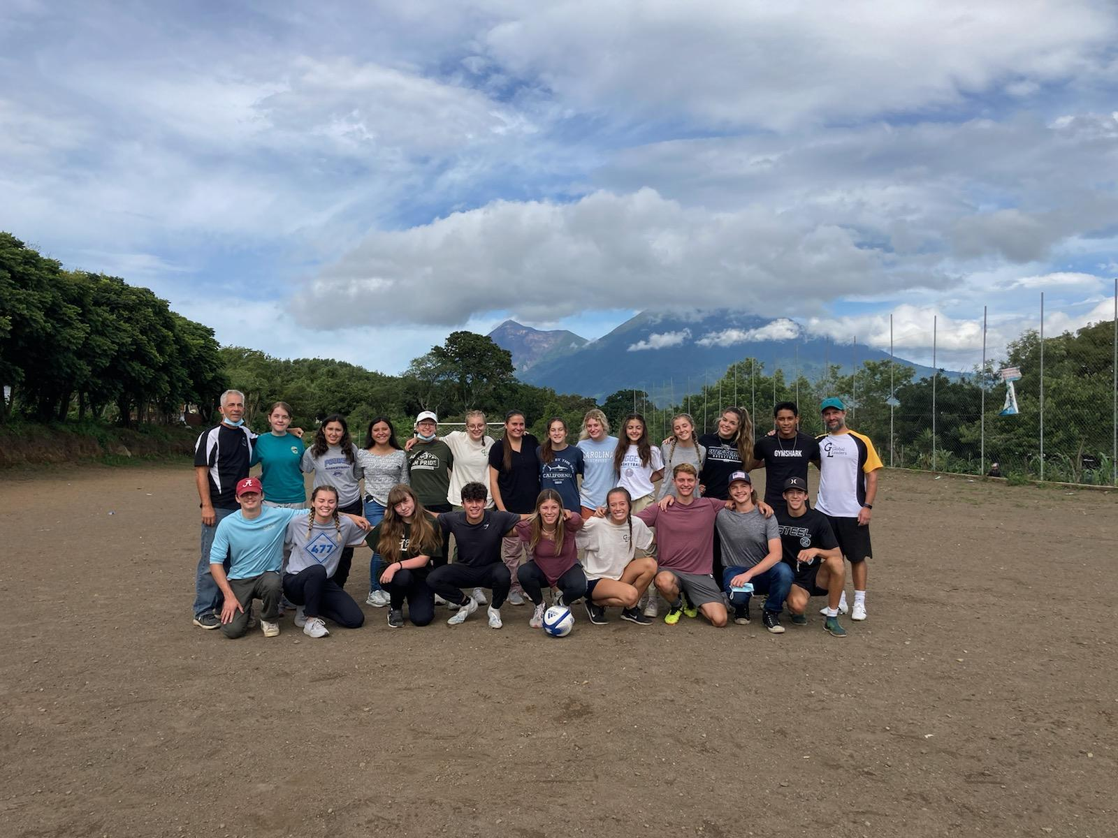
YOUR TWO PROGRAM CHOICES:
LOCAL PROGRAM ONLY:
One hour per week before school, during or after school examples:
Tutoring: Putnam, Irish, Lopez, Best Buddies, Food Pantry, Respite Care, Food Bank, MLK Jr. March, Habitat for Humanity, Environmental Learning Center,
Eight Saturdays Seminar Service Days throughout year (approx. times 10am-4pm)
LOCAL AND INTERNATIONAL PROGRAM:
ALL OF THAT… PLUS 12 day CULTURE/SERVICE/LANGUAGE JOURNEY TO GUATEMALA

Slide 10
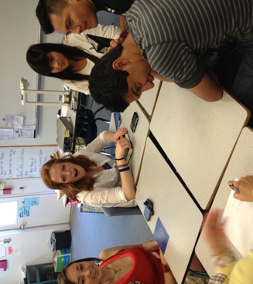
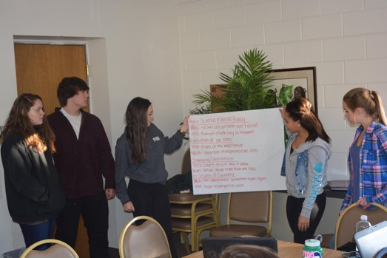
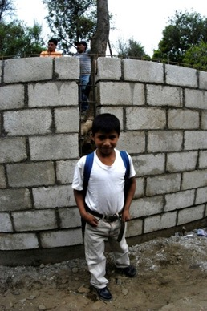
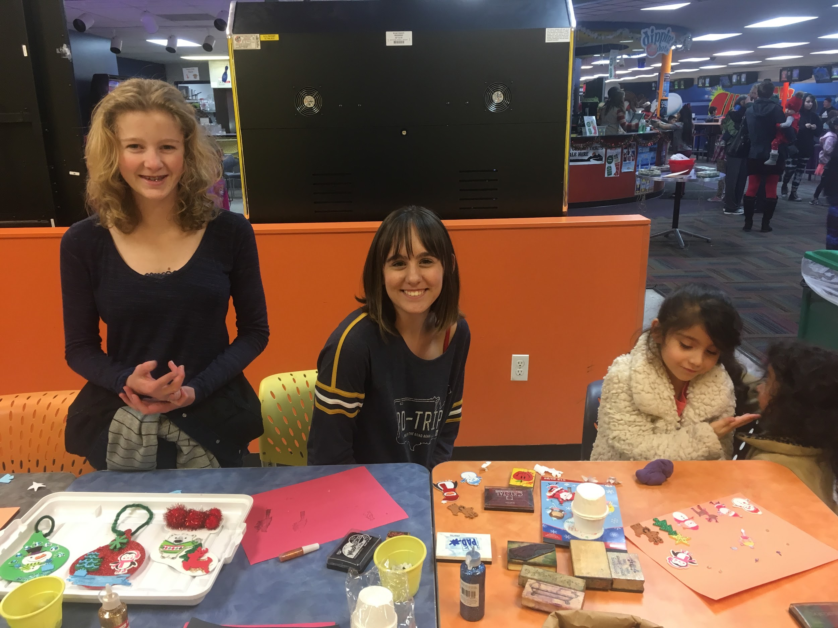
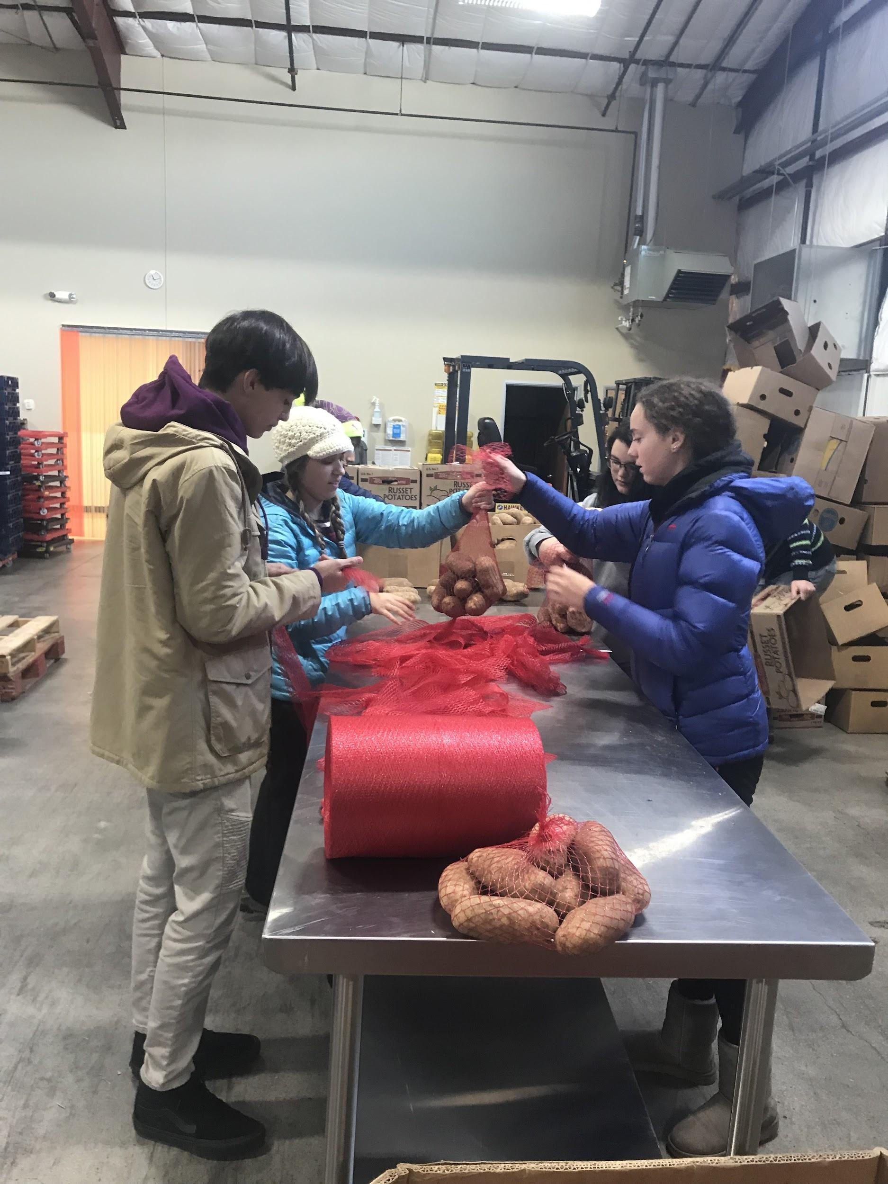
STUDENT INITIATED SERVICE IN NORTHERN COLORADO
SHOE DRIVE
LEADERSHIP RETREATS
INTERCAMBIO
PUTNAM & LOPEZ Mentoring
Poudre HS and Lopez Food Pantry

Slide 11
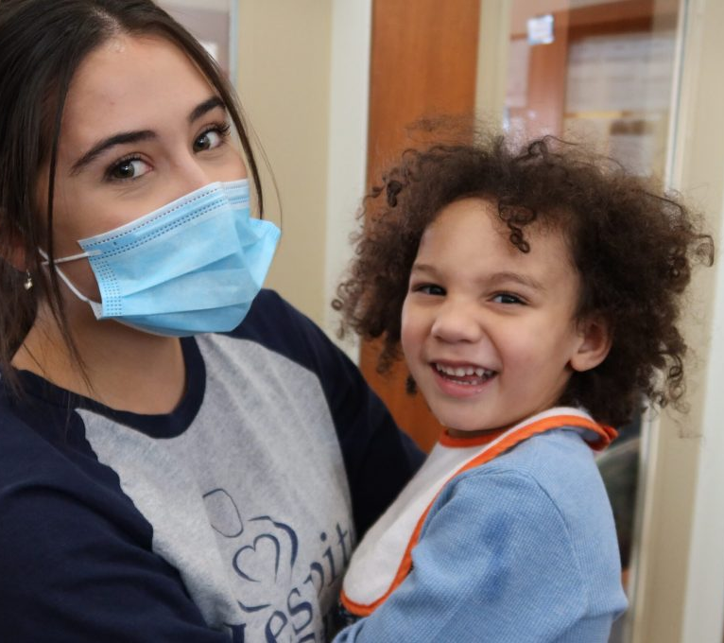
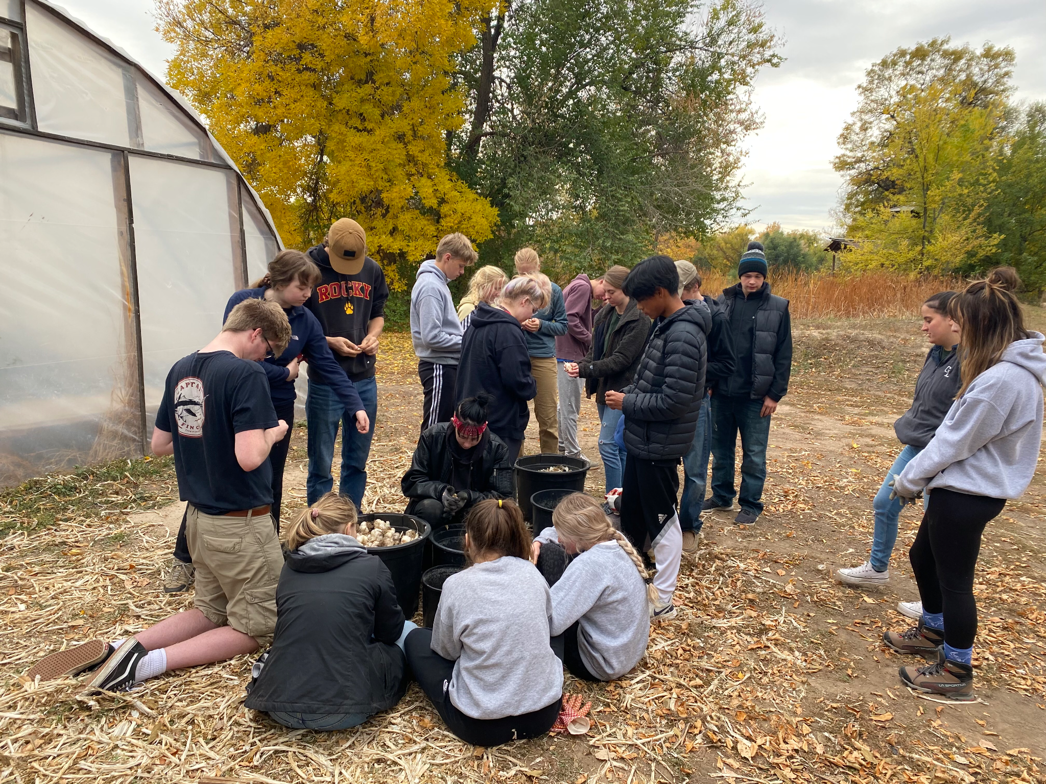
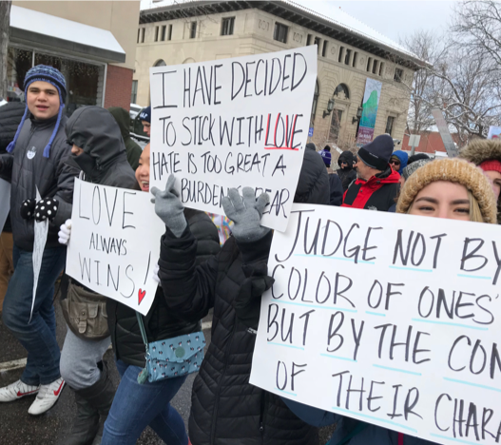
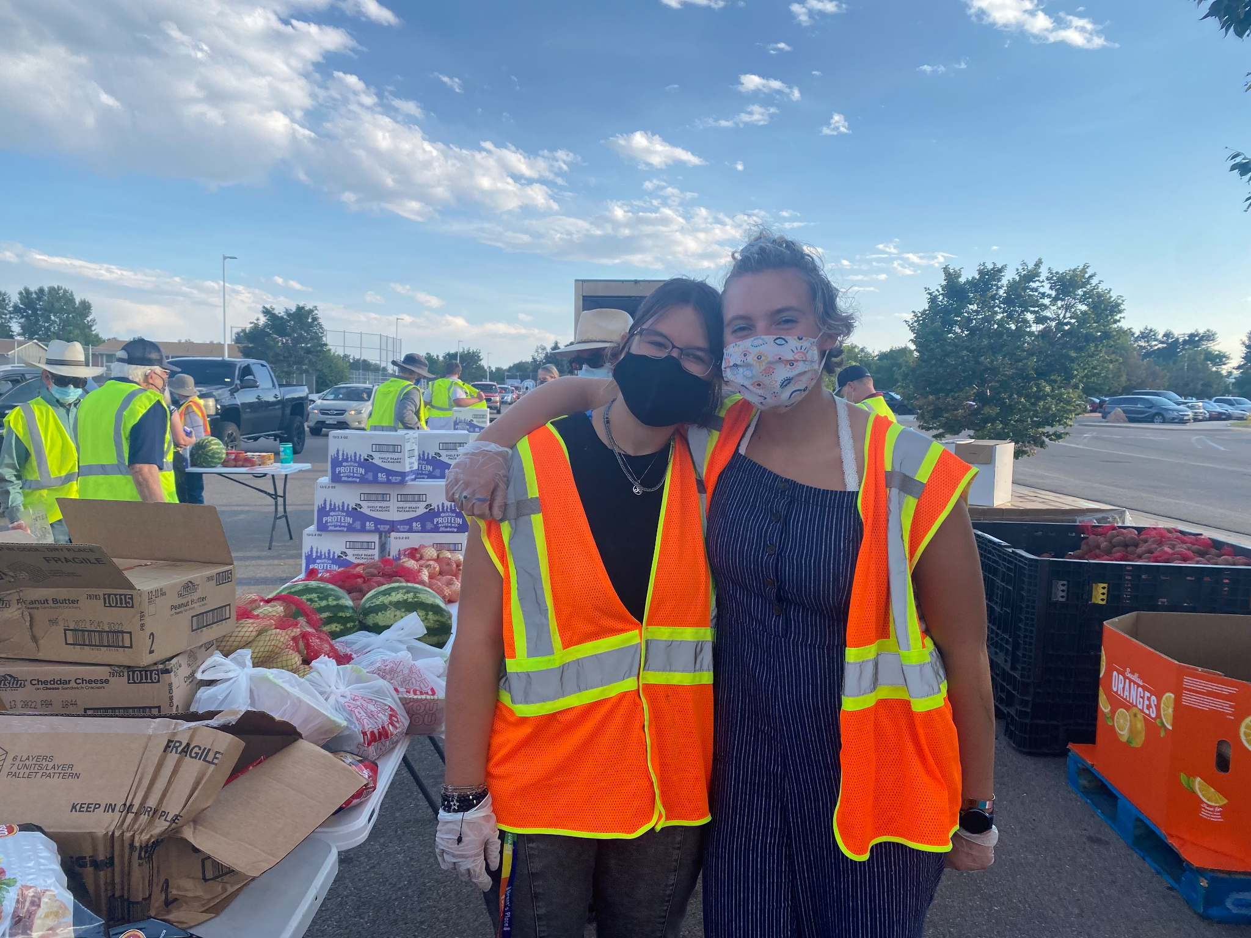
ADDITIONAL SERVICE IN NORTHERN COLORADO
MLK MARCH
RESPITE CARE
LOCAL CSA’S

Slide 12
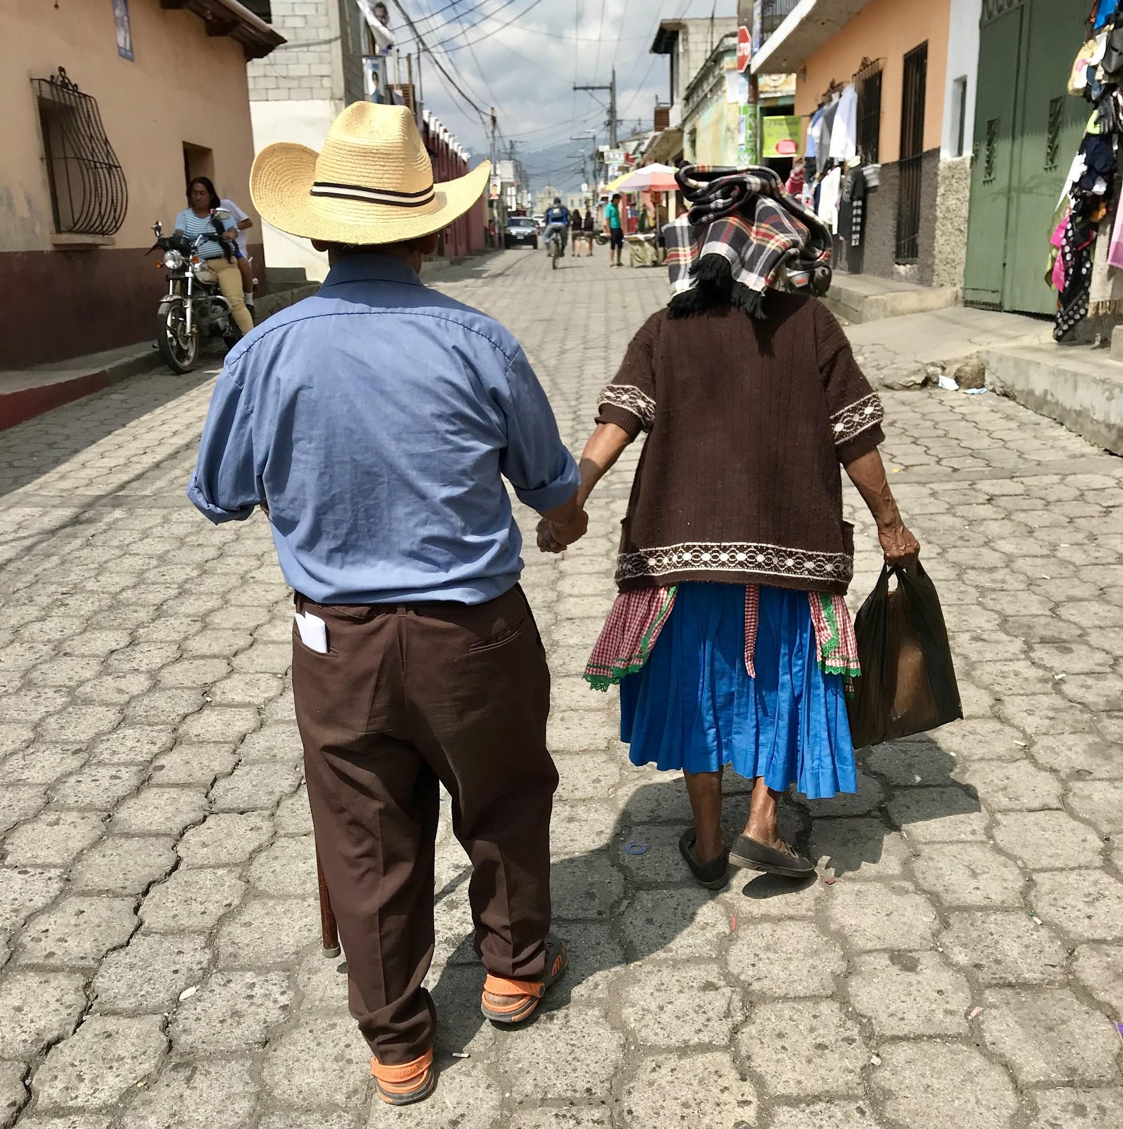
International Projects
Let’s watch what our students have to say about Guatemala Service Projects

Slide 13
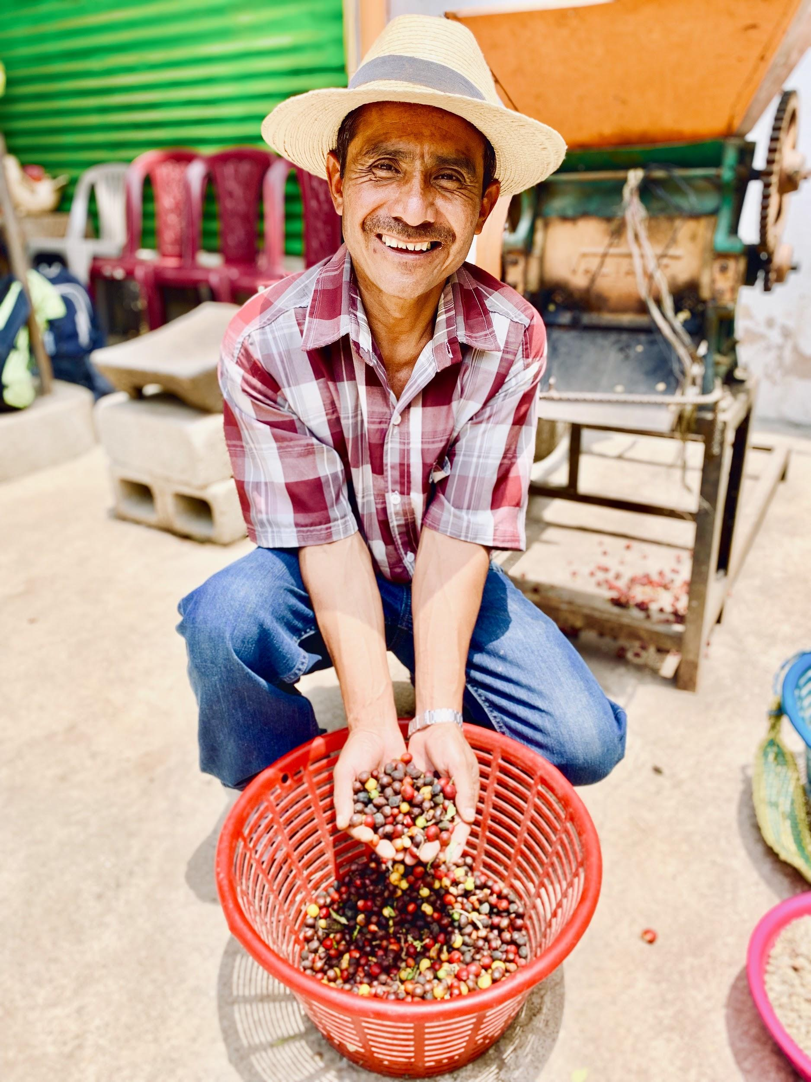
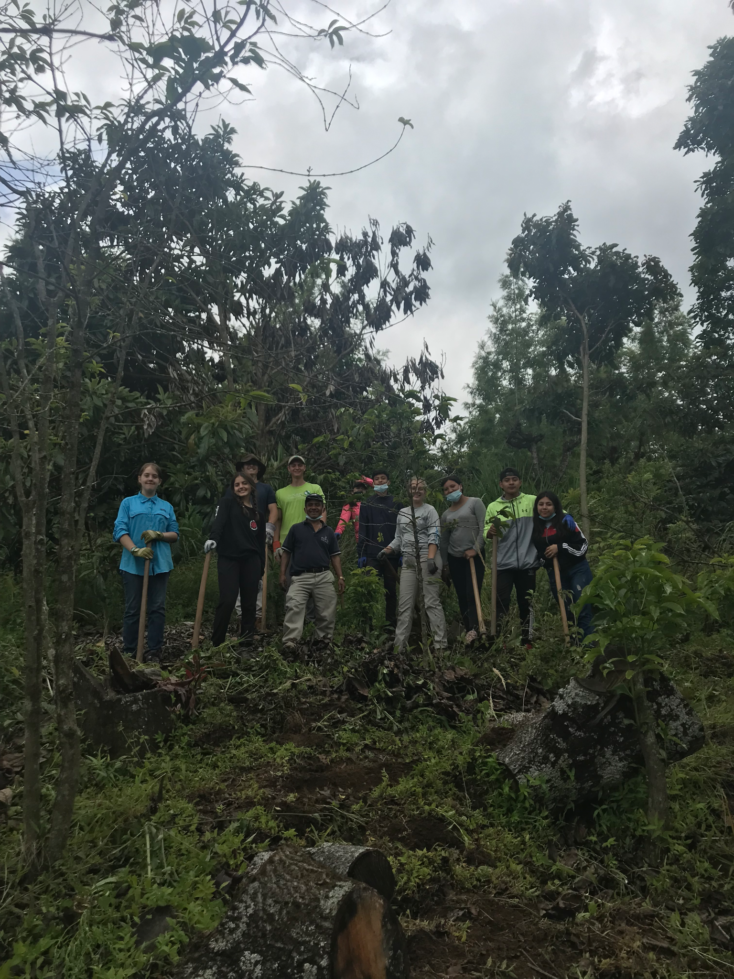
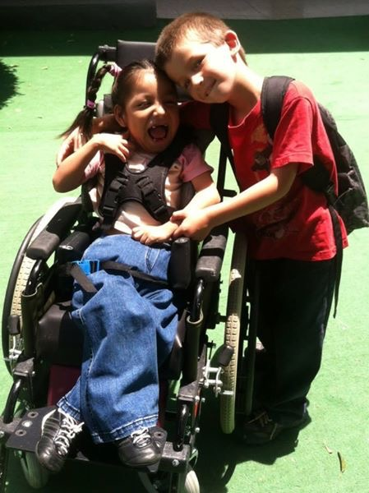
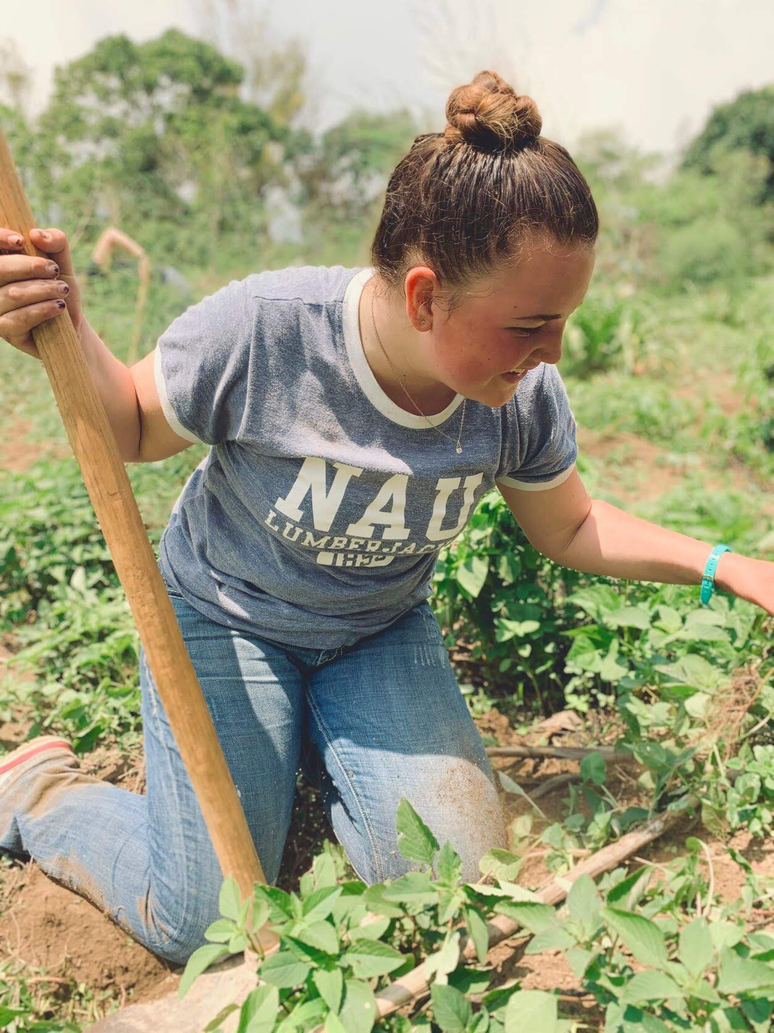
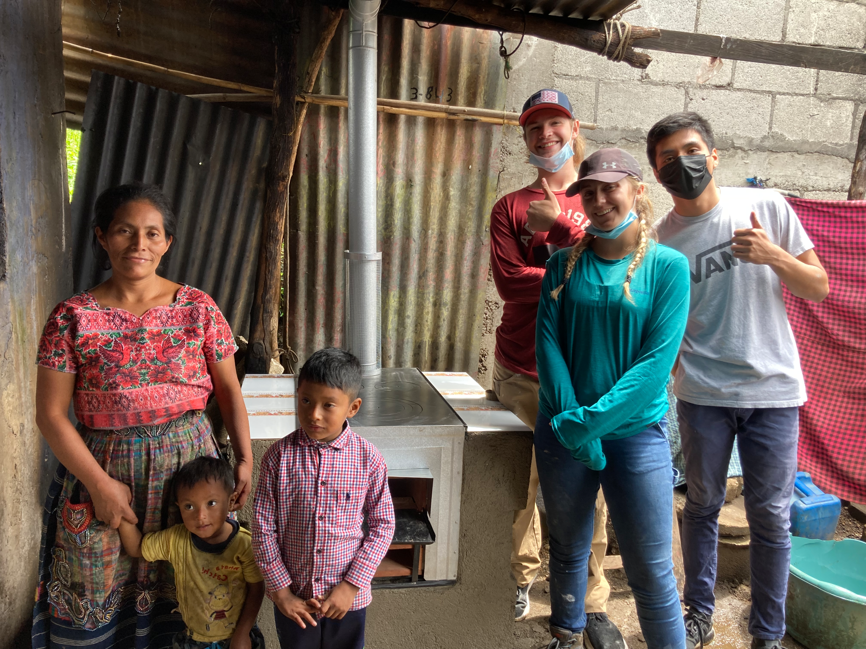
SERVICE IN GUATEMALA
COFFEE COOPERATIVE
VOLUNTEER WORK AT HOSPITAL HERMANO PEDRO
Student Initiated:
INSTALLING CLEAN COOKSTOVES
Reforestation
Notes:
Installing Clean cookstoves is a student initiative project - over 42 clean cookstoves have been installed!

Slide 14
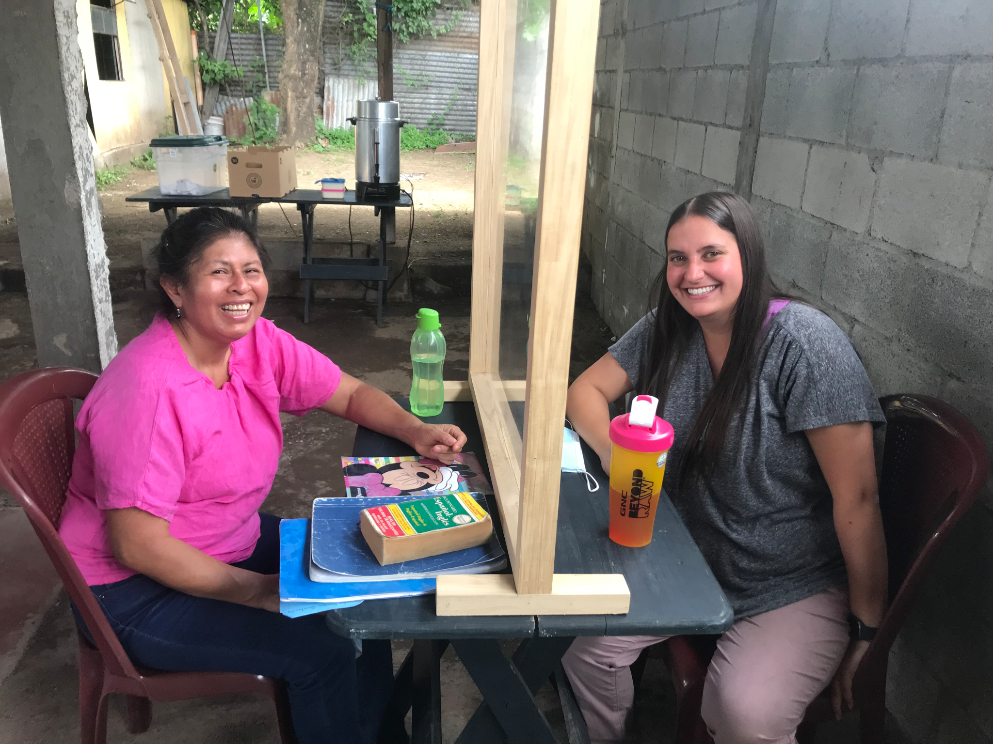
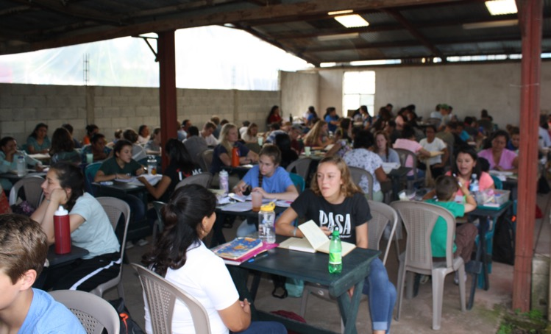
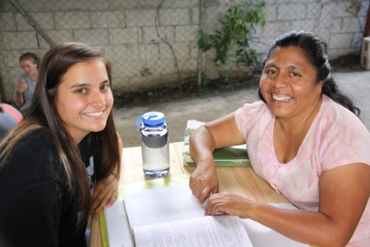
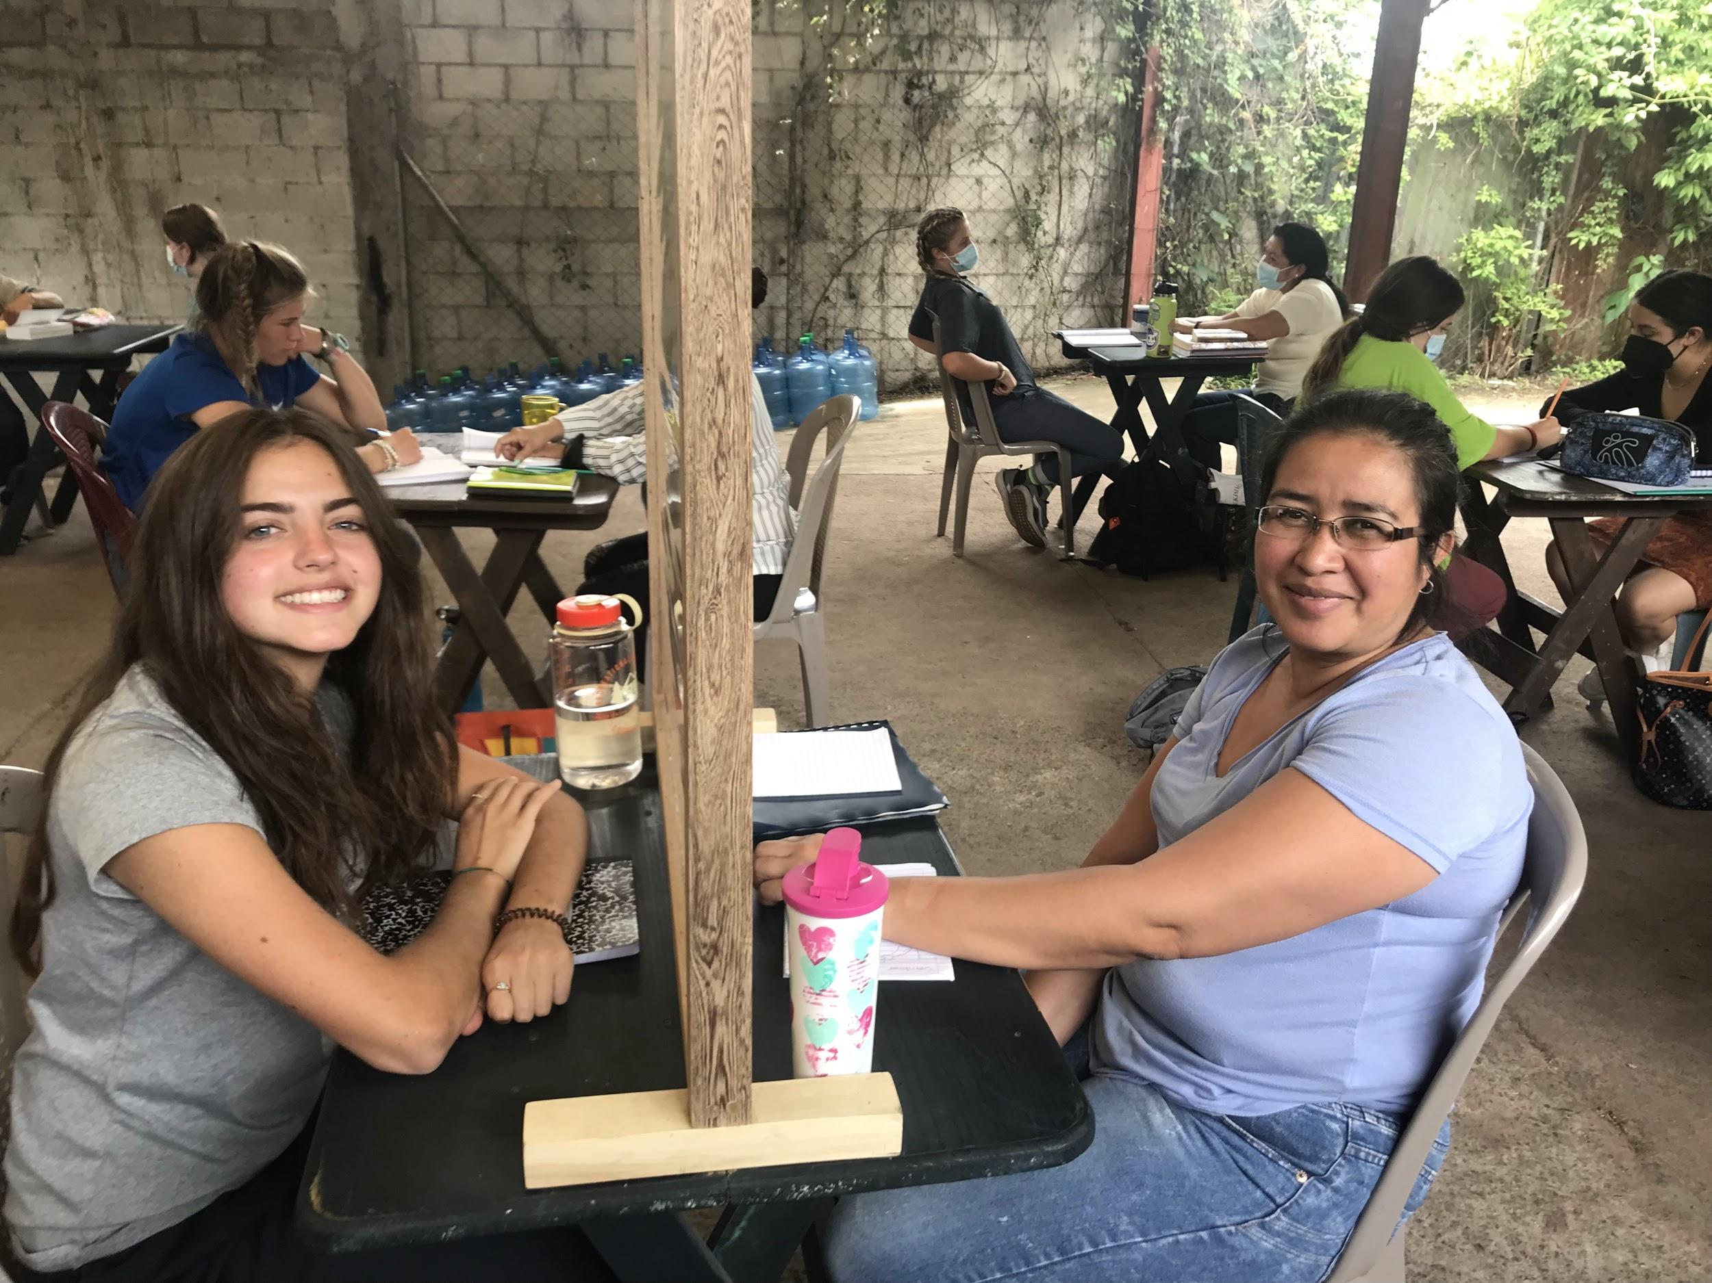
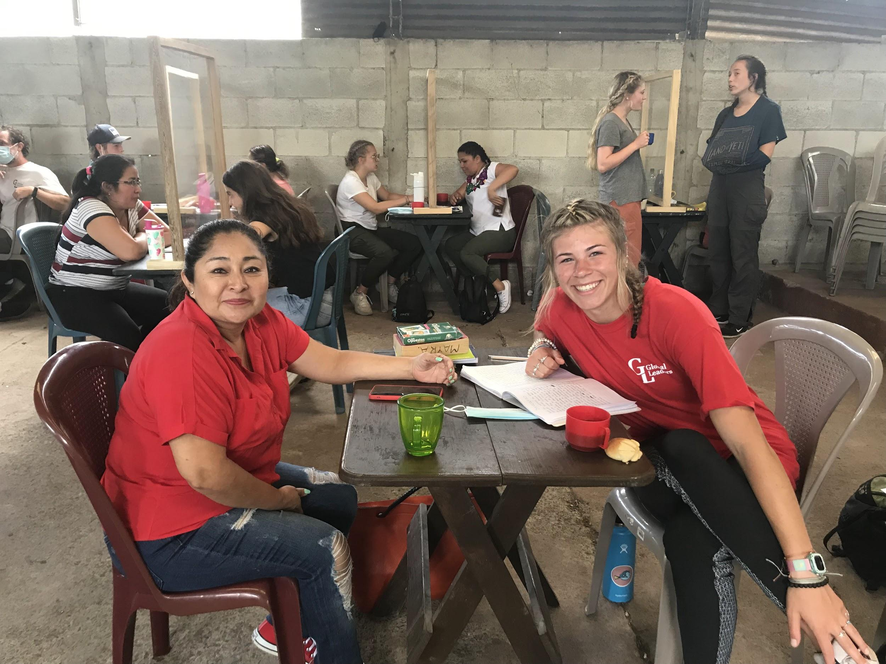
Spanish Language School
One on One Study: Fluent to non existent Spanish
(AND an option to take ZOOM one on one NOW with Guate teachers)

Slide 15
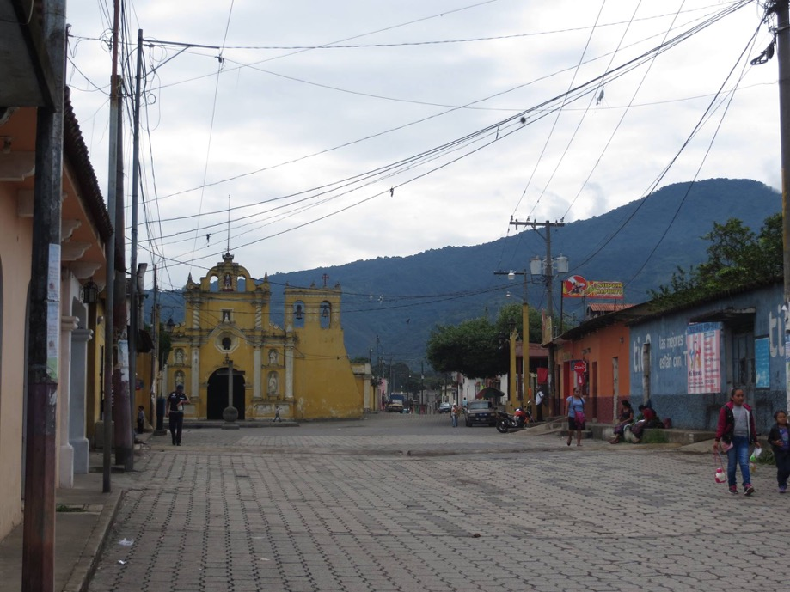
San Miguel Escobar, Guatemala
(Our Little Town)

Slide 16
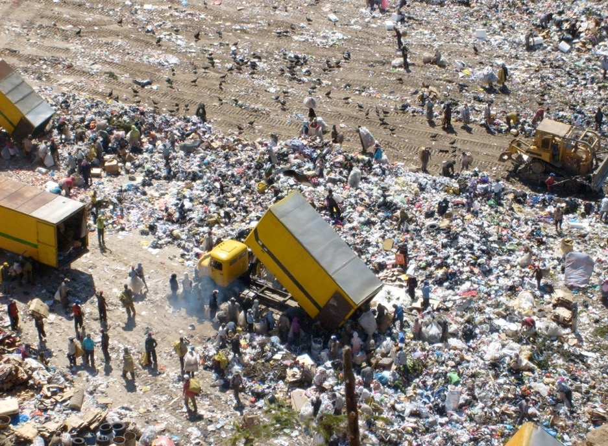
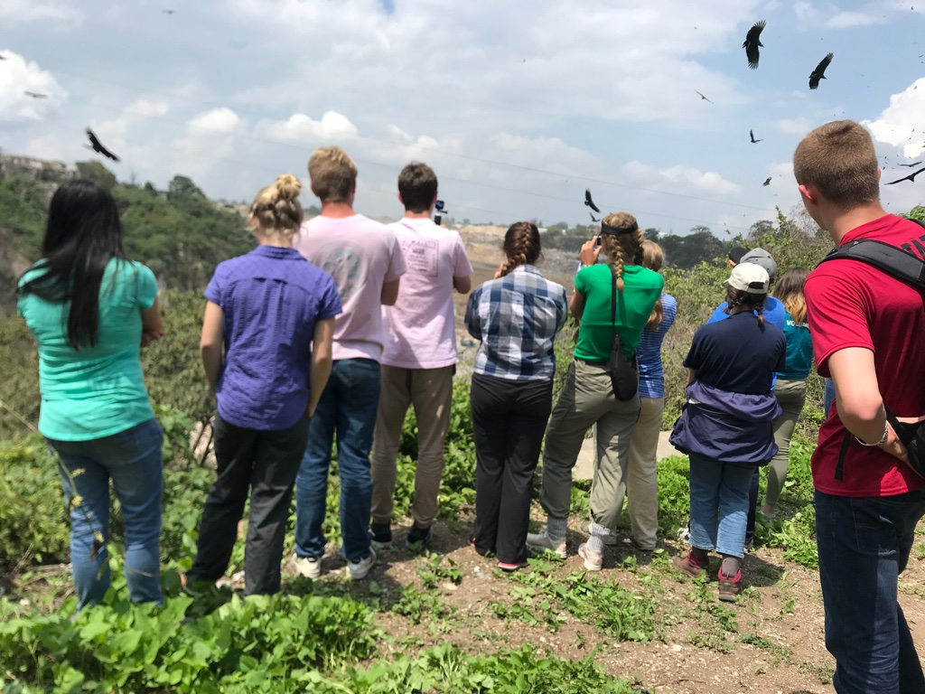
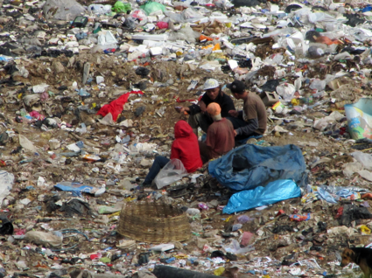
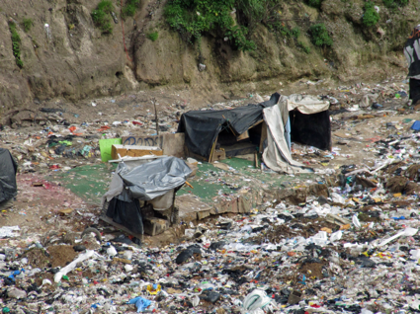
Let’s put things into Perspective

Slide 17
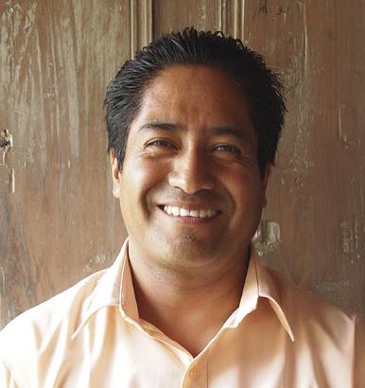
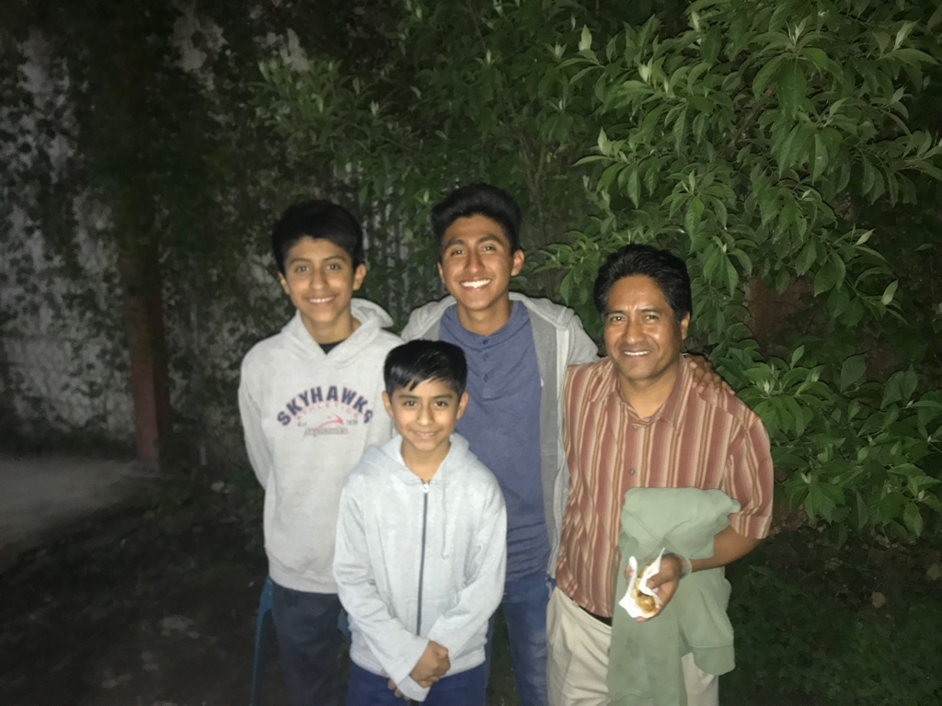
MEET AURELIO - OUR COUNTRY PROGRAM DIRECTOR
AURELIO HERNANDEZ
Aurelio has worked with GL since 2003;
He coordinates all on-the-ground activities
in Guatemala, connecting GL with local
partners for service projects and cultural exchanges. He has worked in Tourism and
Hotel Management since 1994, and holds a degree in Business Administration from the Universidad de Francisco Marroquin.
Aurelio enjoys working with foreign visitors to Guatemala and believes strongly in the benefits of building partnerships between Guatemalans and GL toward a common goal of creating a better living standard for all Guatemalans.

Slide 18
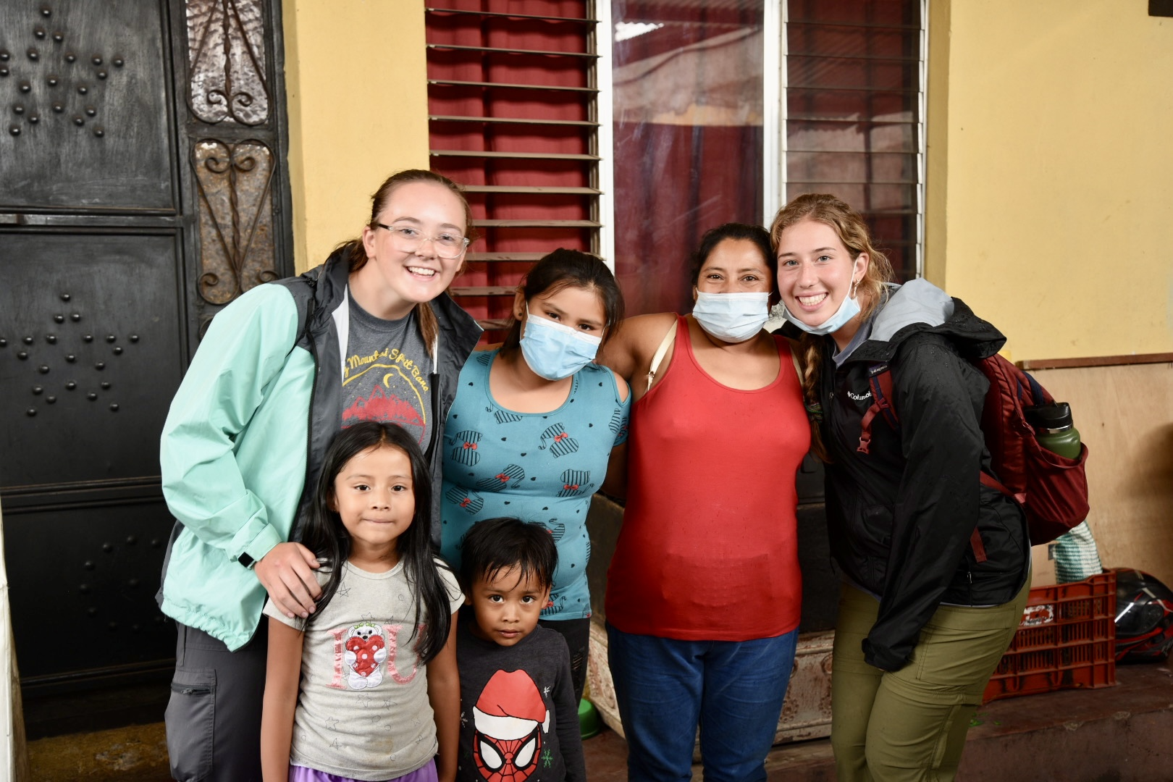
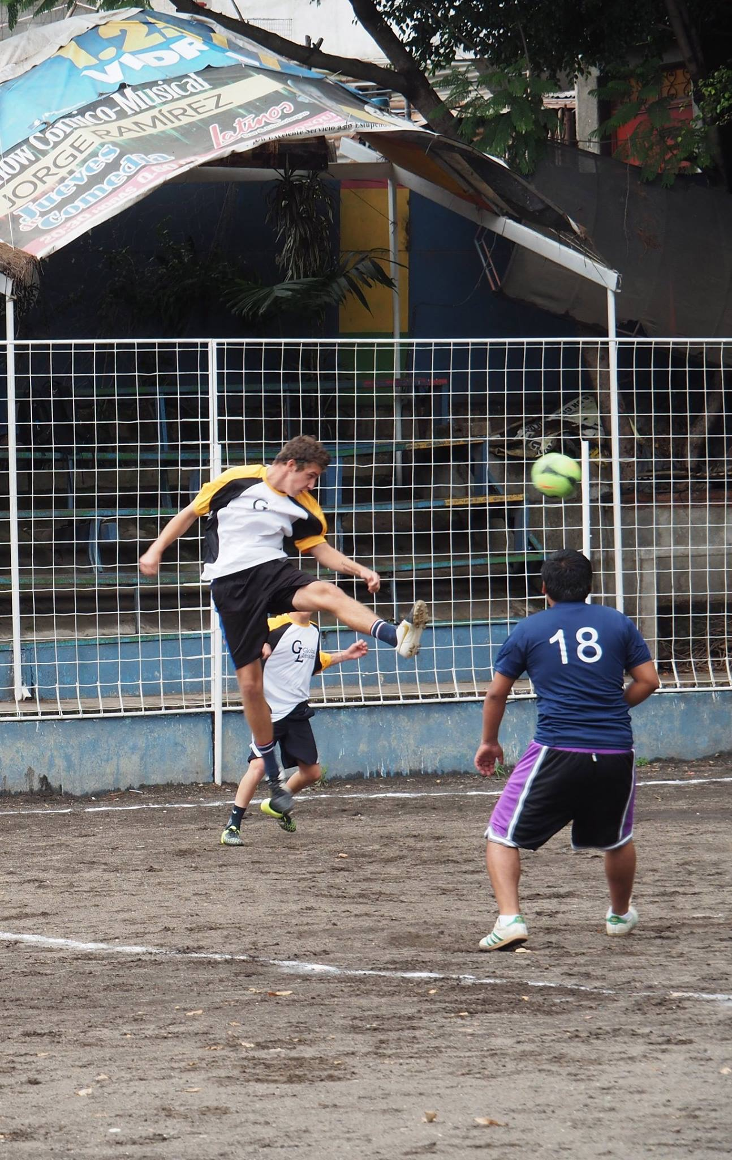
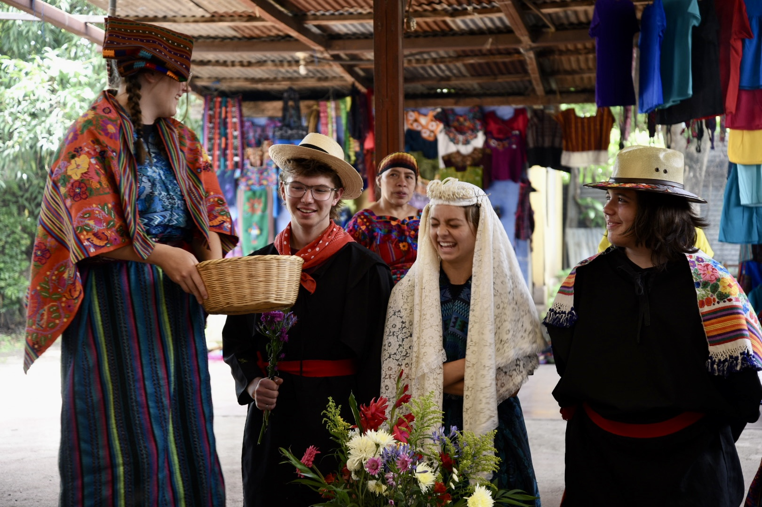
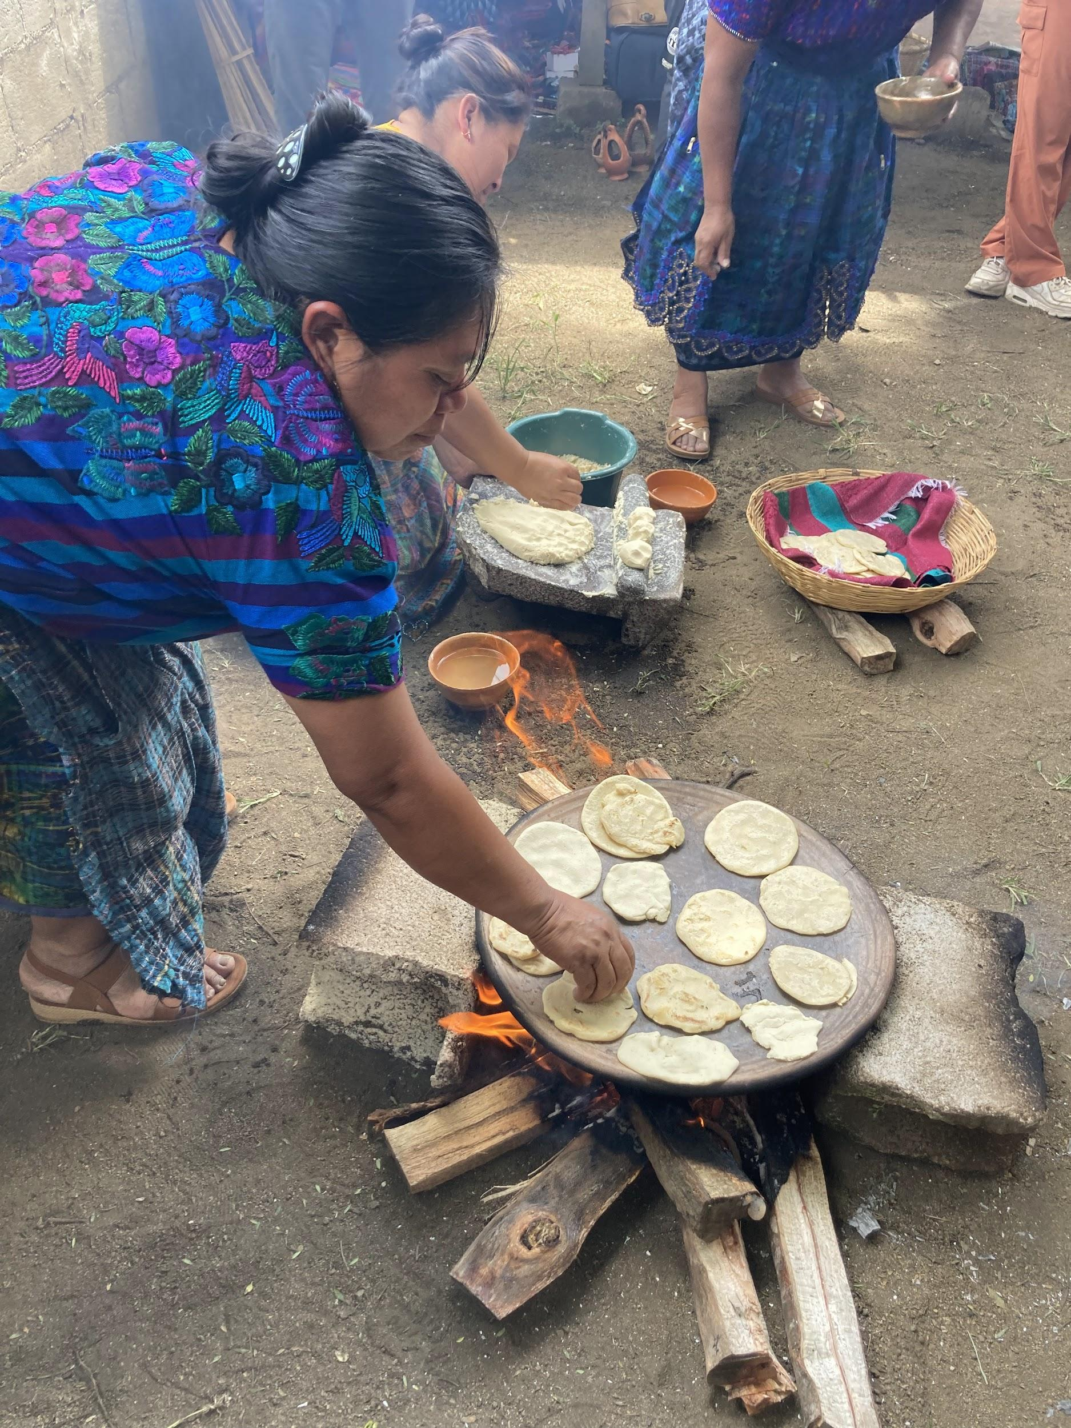
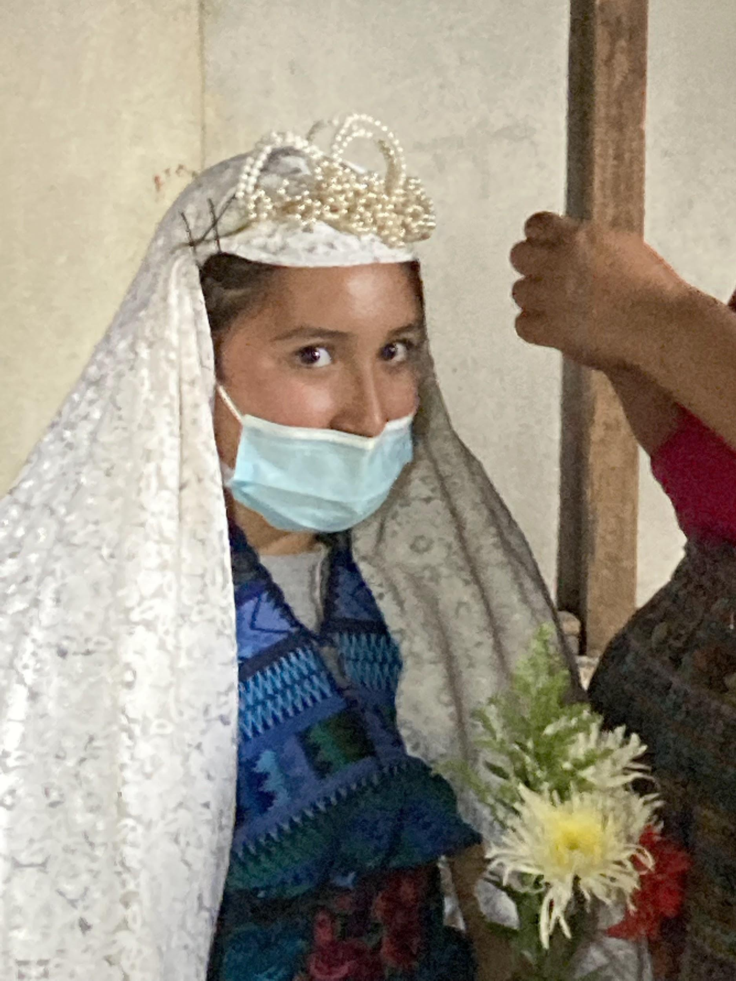
Host Families, Fútbol and Culture!

Slide 19
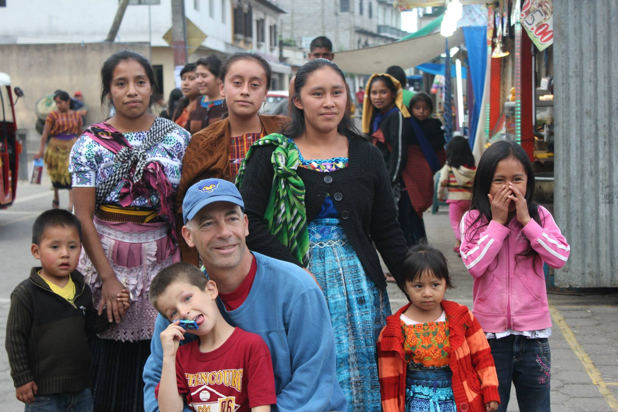
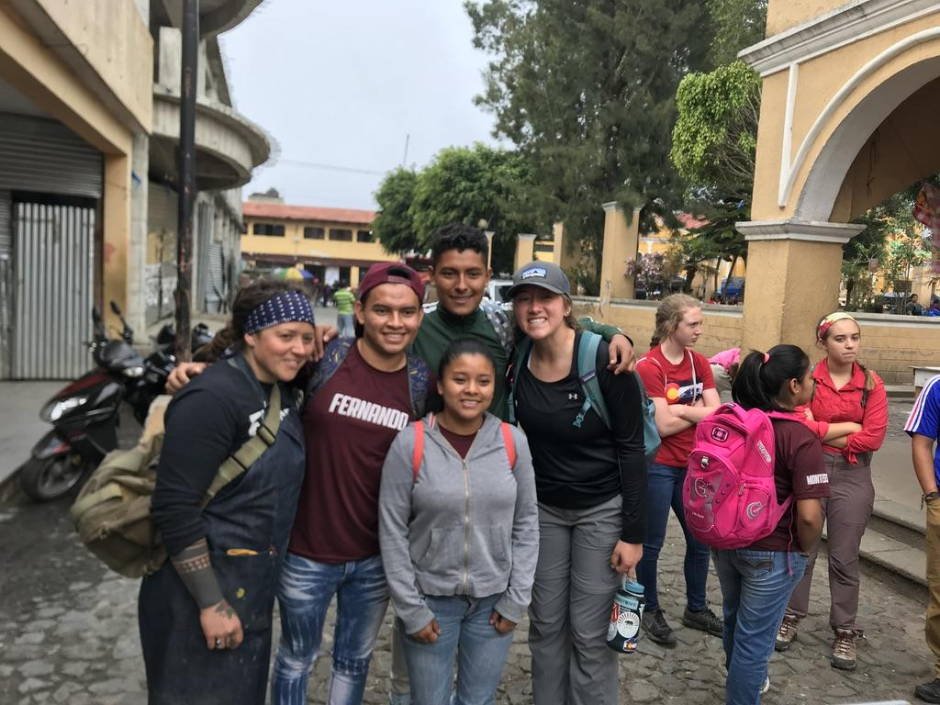
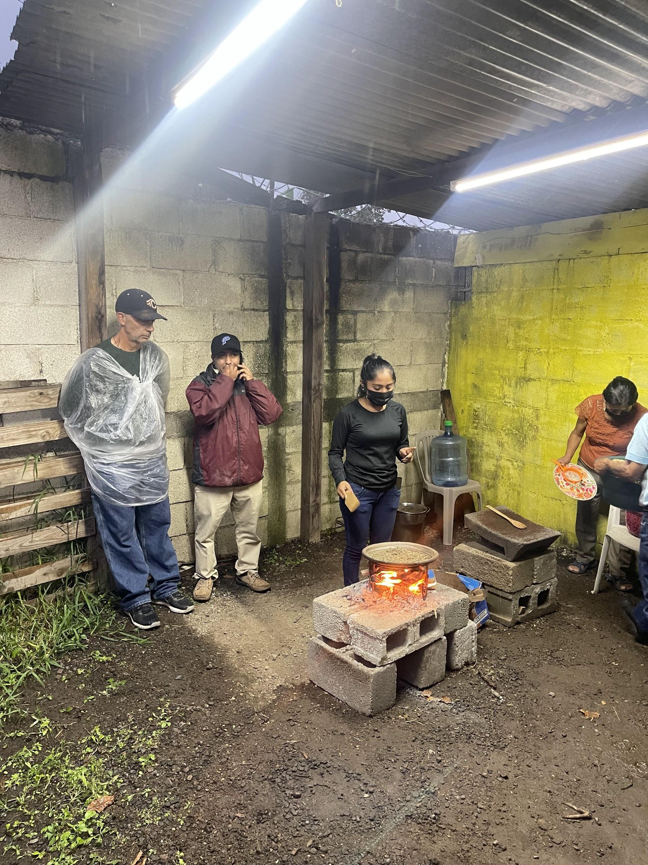
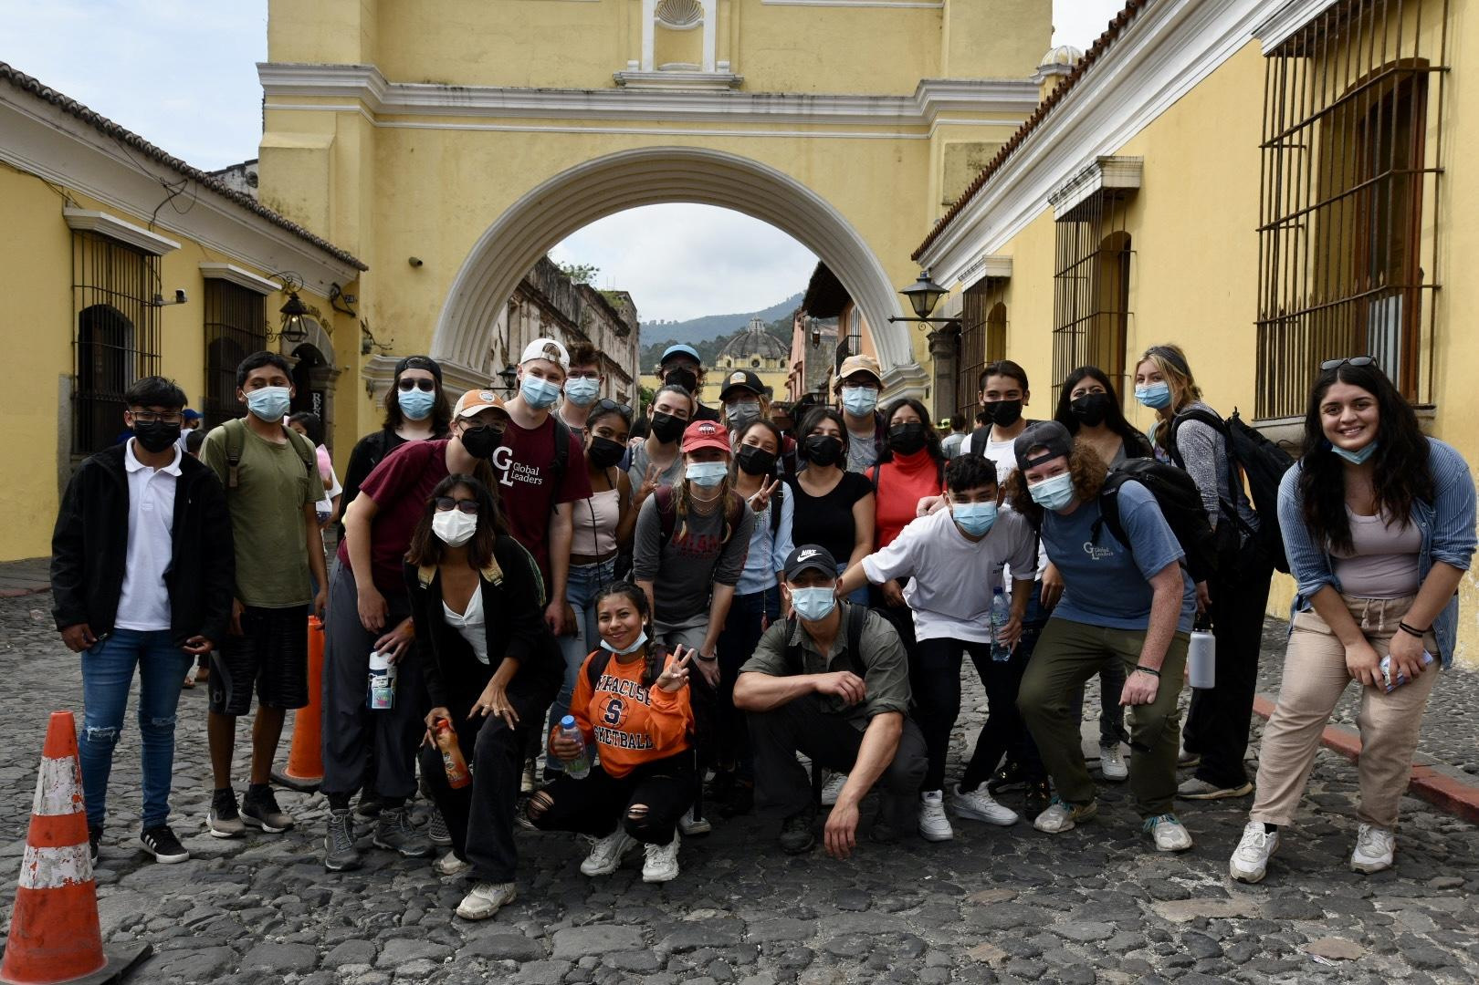
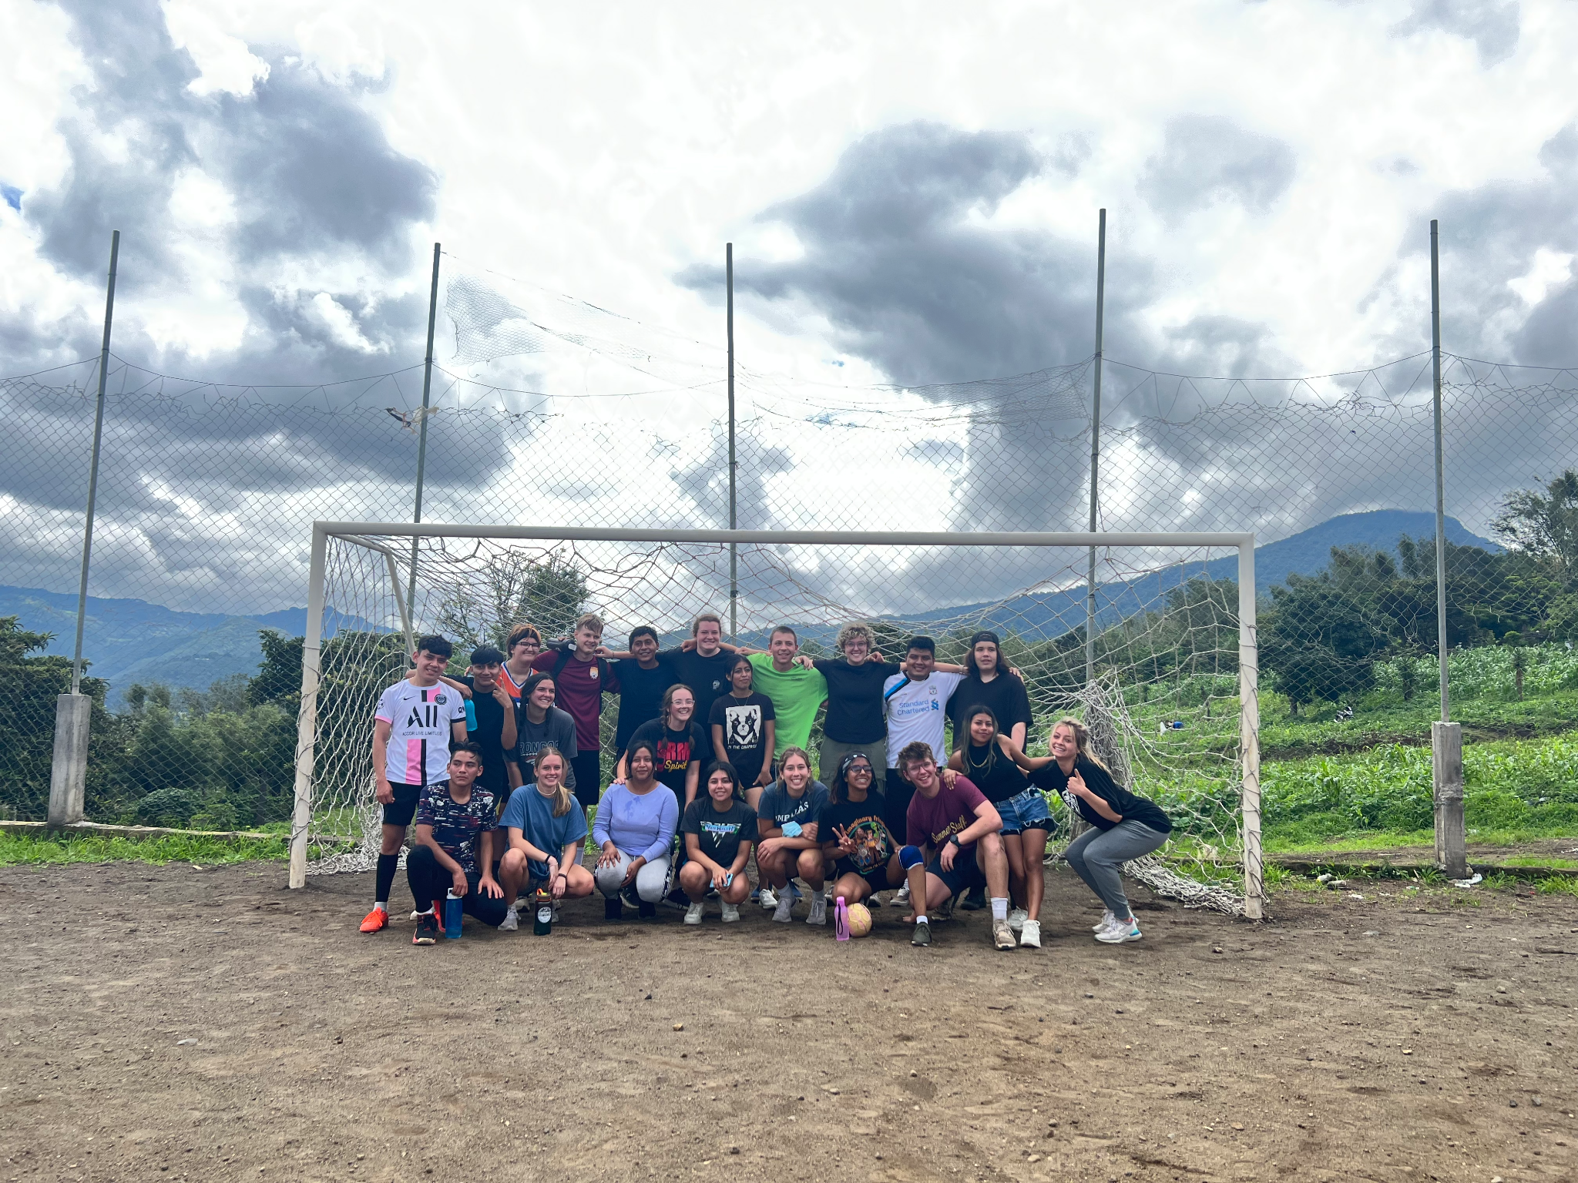
Countless Connections and Friendships

Slide 20
REVIEW OF YOUR TWO GL CHOICES:
LOCAL PROGRAM ONLY:
One hour per week before school, during or after school
examples:
Elementary School Tutoring: Putnam, Irish, Lopez,Best Buddies, Food Pantry, intercambio
8 Saturdays throughout year (approx. times 10am-4pm)
some examples:
Respite Care, Food Bank, MLK Jr. March, La Familia,
Habitat for Humanity, Environmental Learning Center, Humane Society
LOCAL AND INTERNATIONAL PROGRAM:
ALL OF THAT… PLUS 12 day SERVICE/LANGUAGE JOURNEY TO GUATEMALA

Slide 21
WE HAVE SCHOLARSHIPS AVAILABLE!
FOR LOCAL AND INTERNATIONAL PROGRAMS
(you’ll work at our office and earn $ towards program fee)
(Great fundraising as well!)

Slide 22
2022 - 2023 LOCAL PROGRAM COSTS
Our true cost per student for the local program is $1450.
As a member of GL Local Program you are able to participate in all of the GL activities. Most “Local” students end up joining the full program within a year. Some Local students fundraise for a year and then participate in the international portion.
$350
We reduce this cost through fundraising and grants.

Slide 23
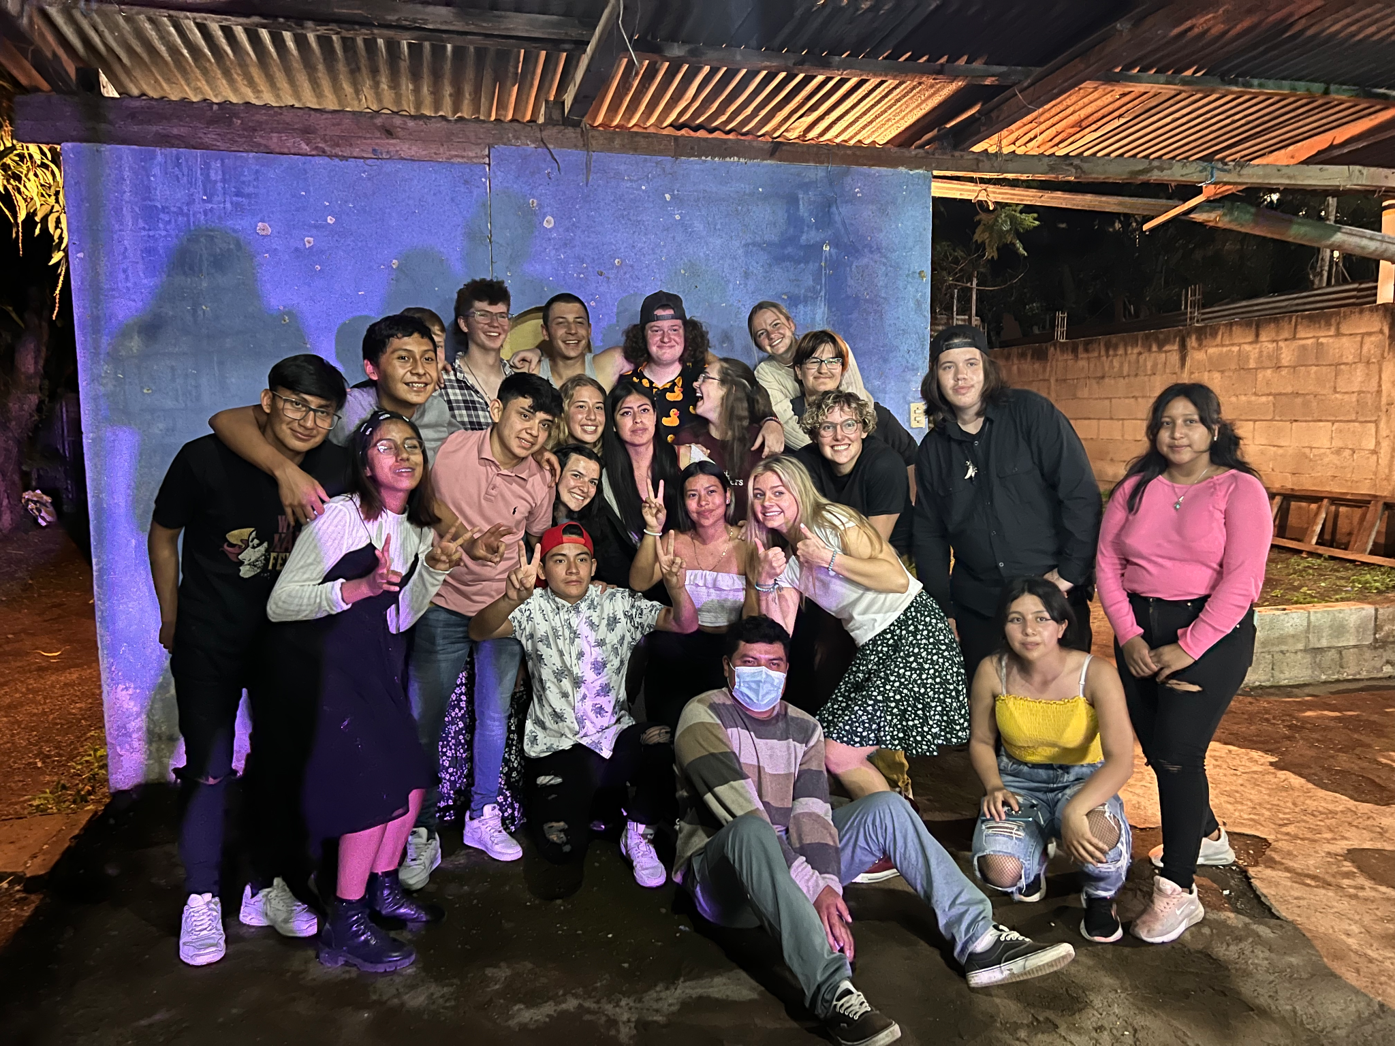
$200 RECRUITING BONUS OFF OF YOUR PROGRAM FEE FOR EACH “NEW STUDENT”*
*New Student = one we have not talked to or had to a presentation!

Slide 24
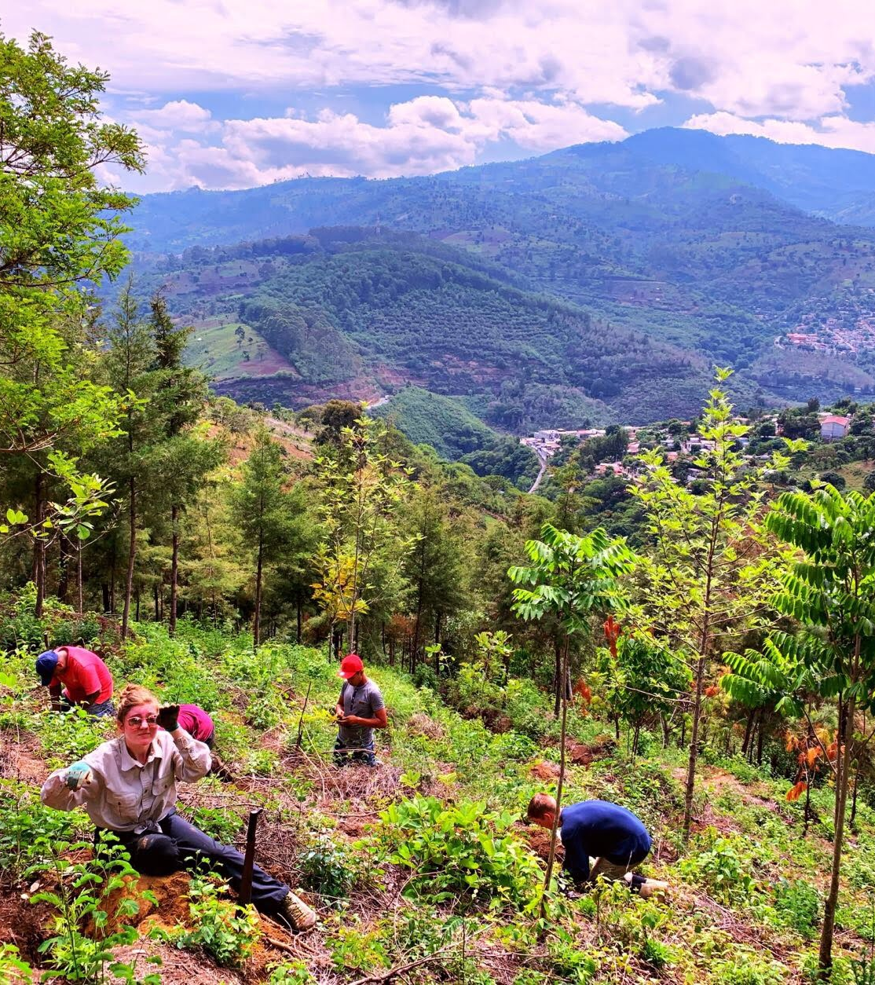
2022-23 DATES AND COSTS
for LOCAL PROGRAM AND
GUATEMALA JOURNEY
DATES | COST | LEADERSHIP RETREAT
JUNE 1-12 | $2950+air | May 29-30 10 AM - 4PM
July 20-31 | $2950+air | July 17-18 10 AM - 4 PM
THIS PRICE INCLUDES EVERYTHING EXCEPT: TRAVEL DAY FOOD,
GUATEMALA GRATUITIES ($175), AND
AIRFARE ($850 - $1000)
Notes:
SATURDAY DEC 11 10 AM 6 PM
JUNE TRIP - MAY 29-30 10 TO 4 PM
AUGUST - JULY 29 - 30 10am 4 PM

Slide 25
SAFETY
Safety always wins over fun
We cannot guarantee safety; but we do everything in our power to be proactive and vigilant
There are dangerous places in every city
Our town is San Miguel Escobar is a sleepy town 4 km from Antigua, Guatemala
Here in Colorado our meetings will follow the county guidelines
All of our students will be need to be vaccinated to be a part of GL
Kids are never unsupervised outside of host families
GL aka “group with the handcuffs”
I’ve brought my children starting at age 5
3 ways to be sent home

Slide 26
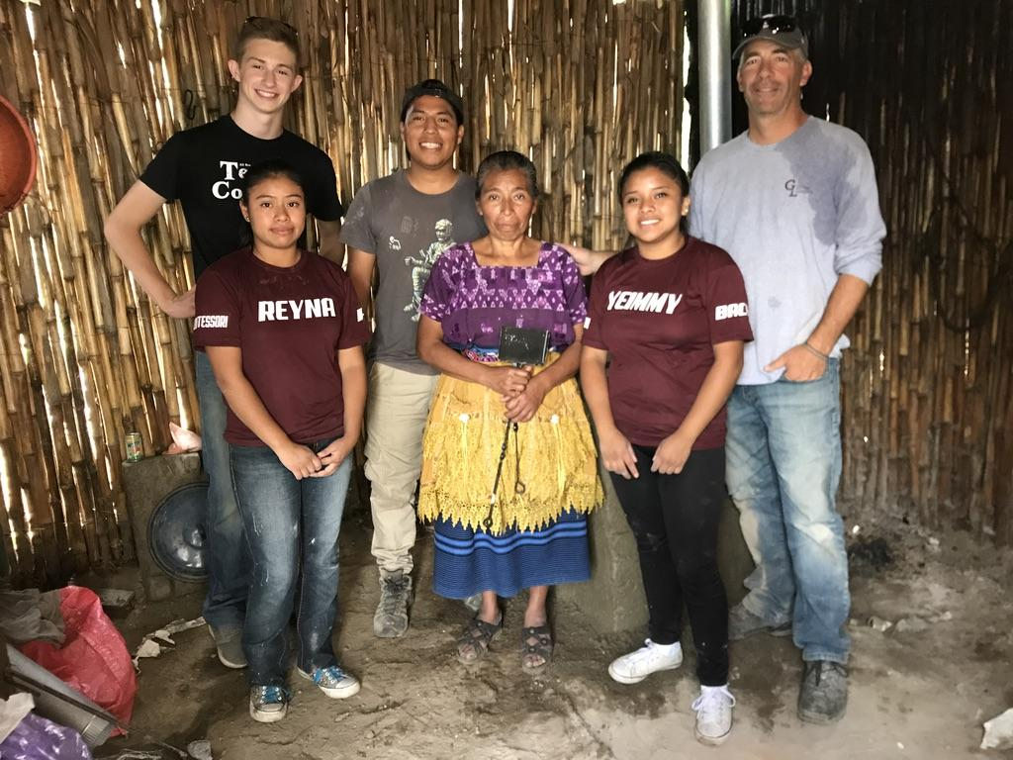
GLOBAL LEADERS STUDENT FUNDRAISING
Fundraising by the GL Team goes towards:
Local service projects/organization
Guatemala service projects
Low-income student scholarships
2019 Fundraising Totals (76 students) 2022 Fundraising Totals (40 students)
*Letter writing: $32,245 *Letter writing: $18,180 *Coffee sales: $4,970 *Coffee sales: $3,097
*Benefit Auction:$51,970 *Benefit Auction: $24,021
ALL STUDENTS PARTICIPATE IN ALL FUNDRAISERS

Slide 27
WORK & EARN AND FUNDRAISING
Work and Earn Program
FUNDRAISING GOAL
MONTHLY PAYMENT PLAN
Money should NOT BE A DECIDING FACTOR FOR A STUDENT JOINING GL.
WE HAVE THE ABILITY TO HELP!
INDIVIDUAL PAYMENT PLAN THAT CONSIST OF:

Slide 28
An Example of The Math!
$2950 Program fee + $850 air = $3800 TOTAL COST
$1900 FINANCIAL AWARD MAX (50% of TOTAL COST)
Student works W&E hours ($20/hr x 95 hrs = $1900)
$3800-$1900= $1900 NEW TOTAL
$75/ month family payment x 12 months = $900
$1900 - $900 = $1000 NEW TOTAL
$225 AUCTION TIX SOLD (5 x $45)
$460 LETTER CAMPAIGN ($20 x 23 letters) (average is $45/letter)
$315 COFFEE SOLD (21 bags x $15)
$1000- $1000= $0 NEW TOTAL
This student would have to come up 0!

Slide 29
APPLY NOW!
Check out our website:
www.globalleadersinc.org
CALL US with Questions!
(970) 672-7060

Slide 30
Info and Commitment Meetings:
Parent/Student INFO MEETING: (ATTEND ONE INFO MEETING)
September 6th:
6:00 PM @ Poudre High School
7:30 PM @ Rocky Mountain High School
September 13th:
6:00 PM @ Rocky Mountain High School
7:30 PM @ Poudre High School
September 20th:
6:00 PM @ Poudre High School
7:30 PM @ Rocky Mountain High School
September 27th:
6:00 PM @ Rocky Mountain High School
7:30 PM @ Poudre High School
Commitment Meeting
October 11th @ Poudre High School
Notes:
TELL STUDENTS TO TAKE A PIC OF SLIDE

Slide 31
Scan the QR code!
Let us know by filling our form out!

Slide 32
THE end!

Slide 33
THE HUGS! (Making a Comeback!)

Slide 34
Spanish Language Lessons with GL!!
Whether or not you decide to sign up for Global Leaders, we have 1 on 1 Spanish lessons with our teaching staff from Guatemala!
Classes are $15 an hour via Zoom to have direct conversations and lessons
All costs pays your Spanish teacher directly
You can be in any Spanish level
You DO NOT have to sign up to be a GL student to take these classes!
Help teacher’s families in Guatemala as you polish up your Spanish skills!
Notes:
If you’re interested in GL and would like to polish up on your Spanish skills, we have one-on-one Spanish language classes available for ALL Students!! You do not need to be a GL Student to sign up for these classes!

